Slide 1




Graphic Products
GCSE Presentation

Slide 2


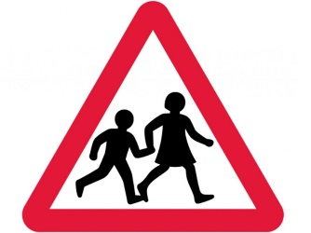
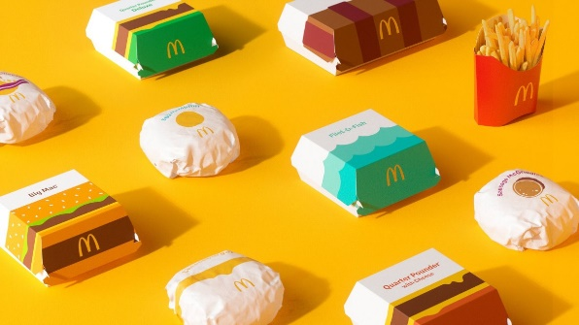
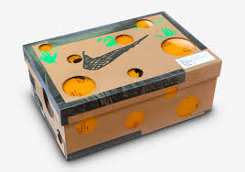
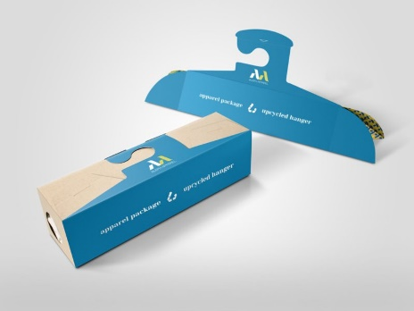

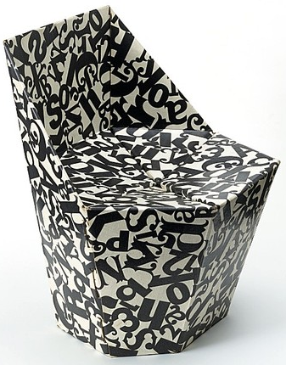
What is ?
Graphic Products
Graphics is a broad and interesting area of design focusing on both 2D and 3D elements. The focus is often on the appearance of products.
Posters, magazines & websites
Packaging and printing
Logo design & branding
Fonts & lettering
Graphic Design is generally 2D
Graphic Products are 3D, including:
Packaging
Pop-up toys
Pop-up furniture

Slide 3
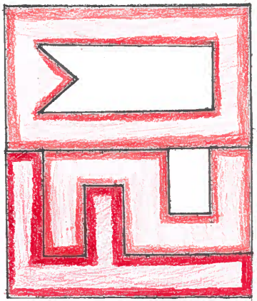


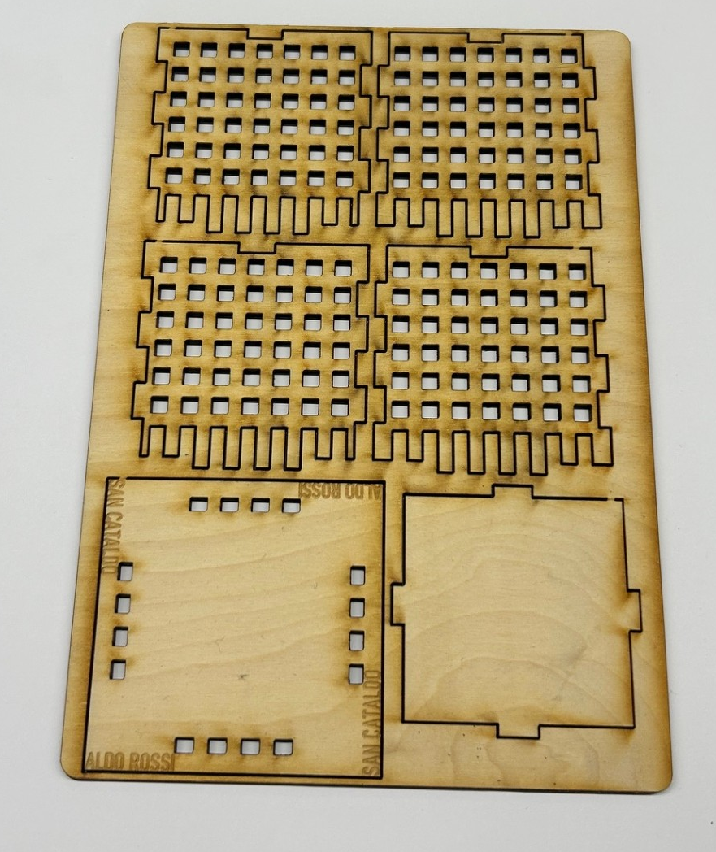

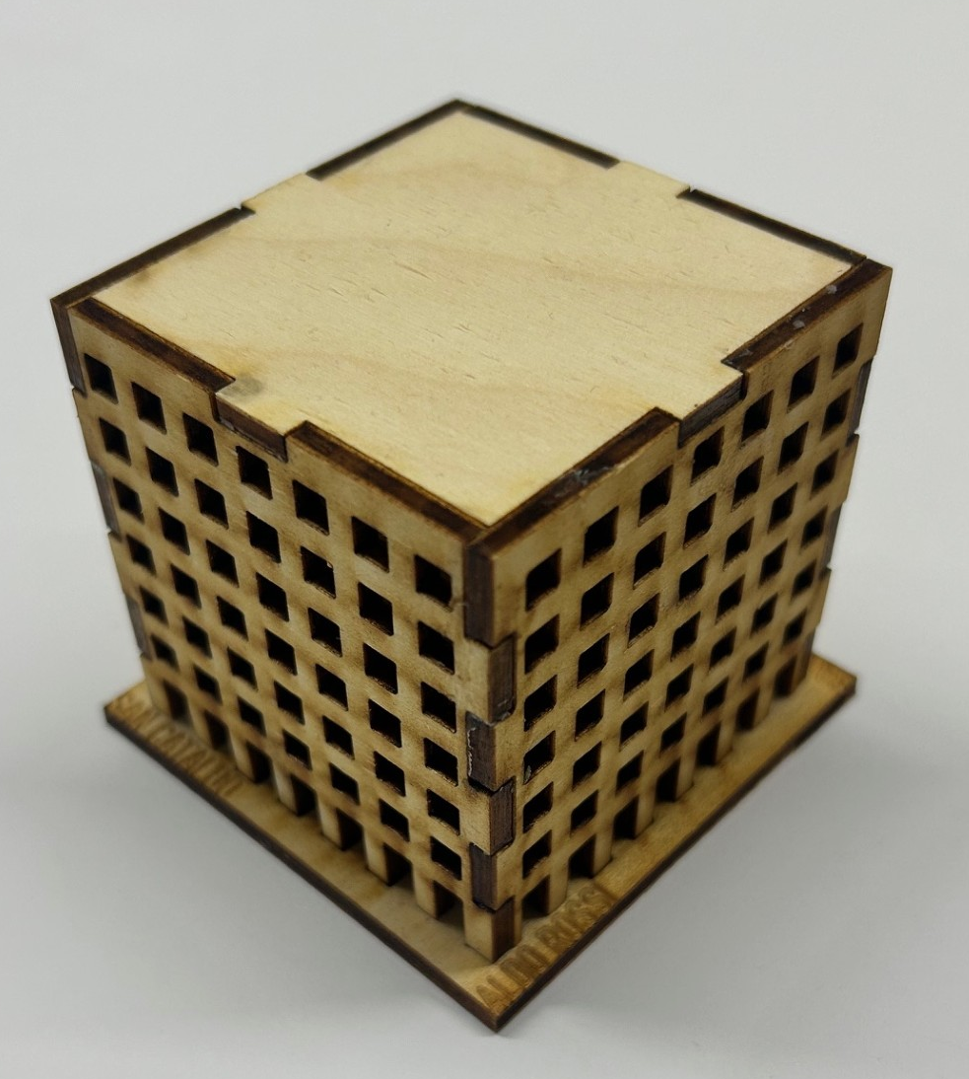
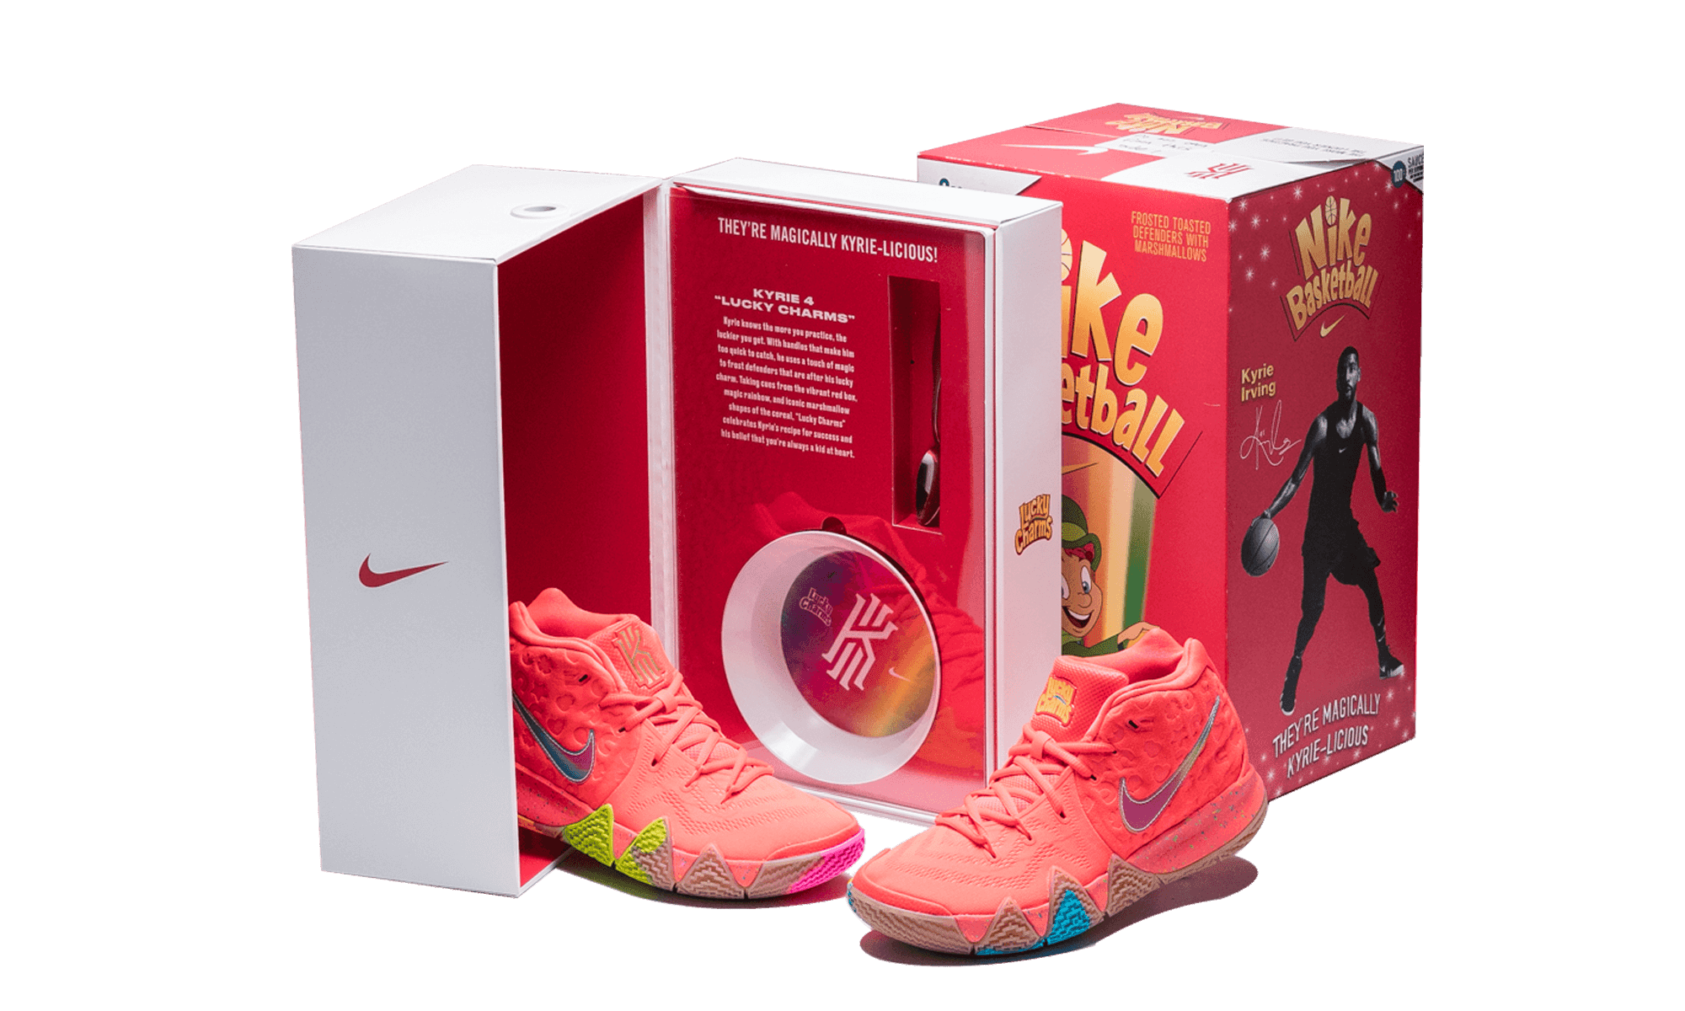
Yr10
Graphic Products
Logo design
‘Trainer packaging’ project
Architectural toy
Mock NEA
NEA - GCSE major project

Slide 4
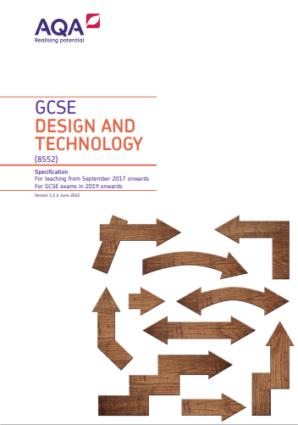
Yr11
Graphic Products
Major Project
Contextual Challenges are provided by AQA. Examples of Project Contexts:
High Profile Activity or Event.
Keeping Fit and Active
Working Towards a Sustainable Future.
Product outcomes are developed by students using the skills and knowledge developed in Yr10.

Slide 5
Why choose ?
Graphic Products
It’s fun and creative
Blend of practical, design work and theory
Passion for everything related to Graphic design
To develop your own brand / merchandise
It could lead to careers in:
Graphic design
Interior/set design
Marketing & advertising
Game development
and many more…

