Slide 1

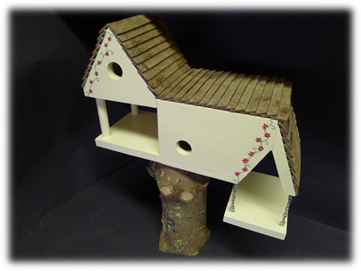
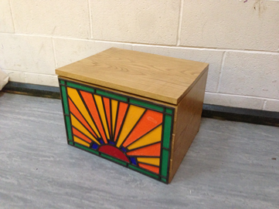




Resistant Materials
Design and Technology GCSE Presentation

Slide 2

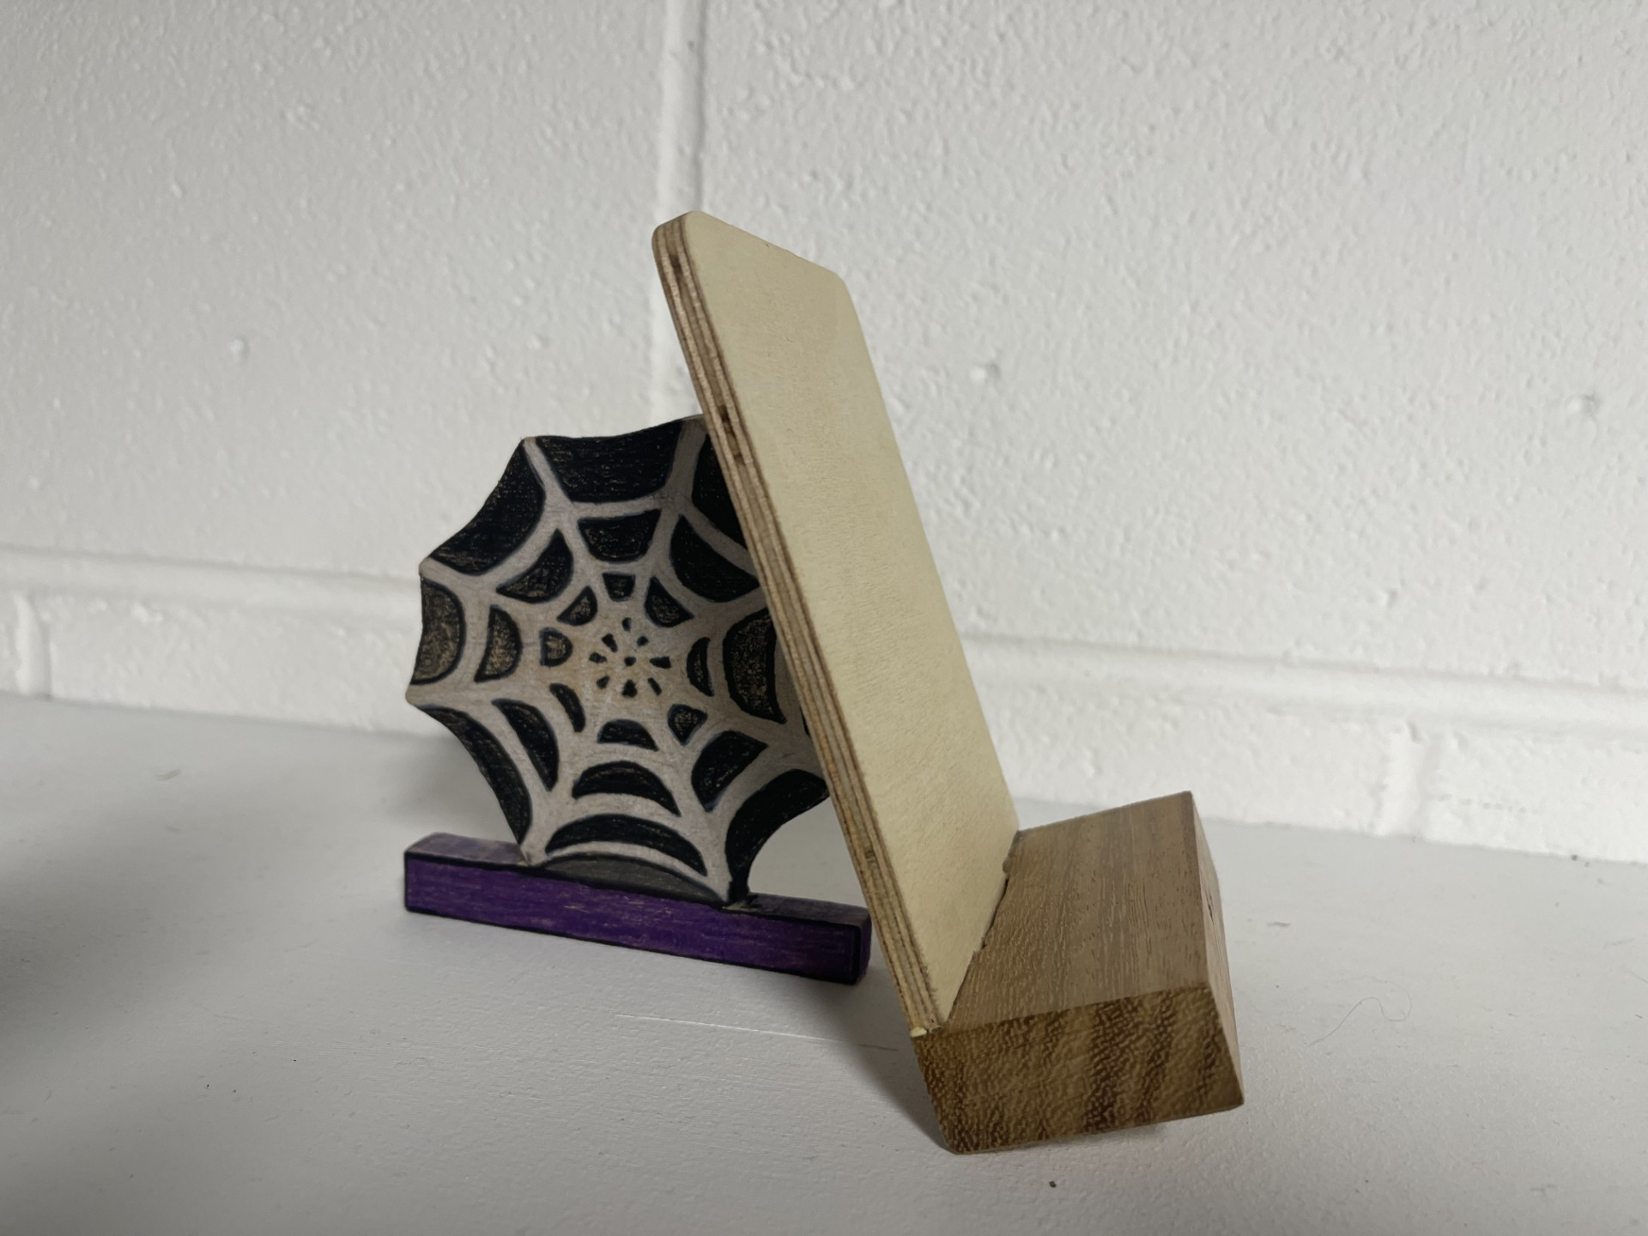
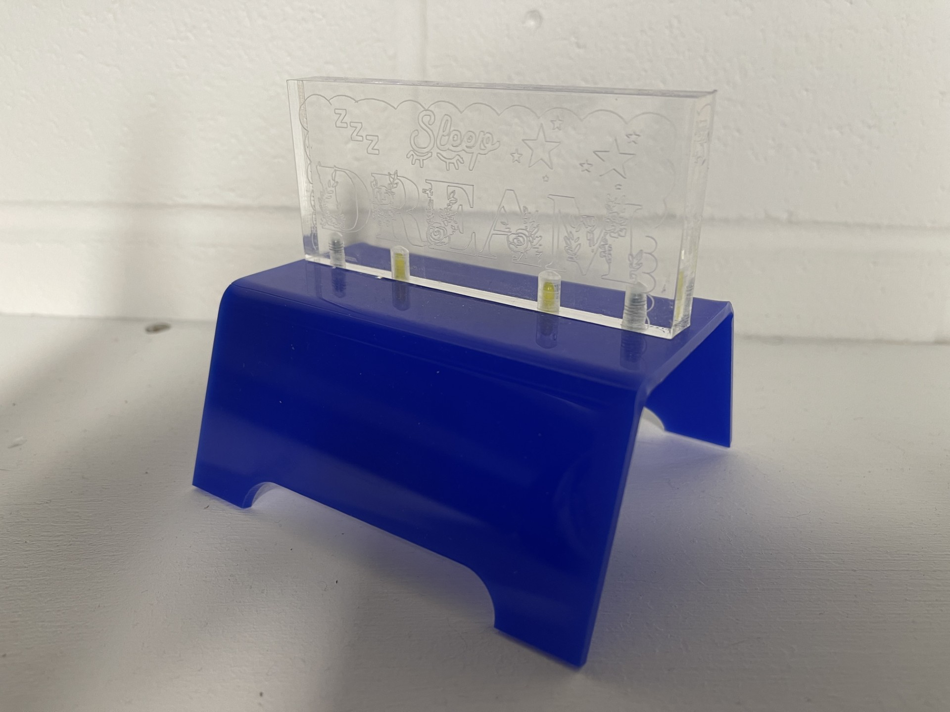
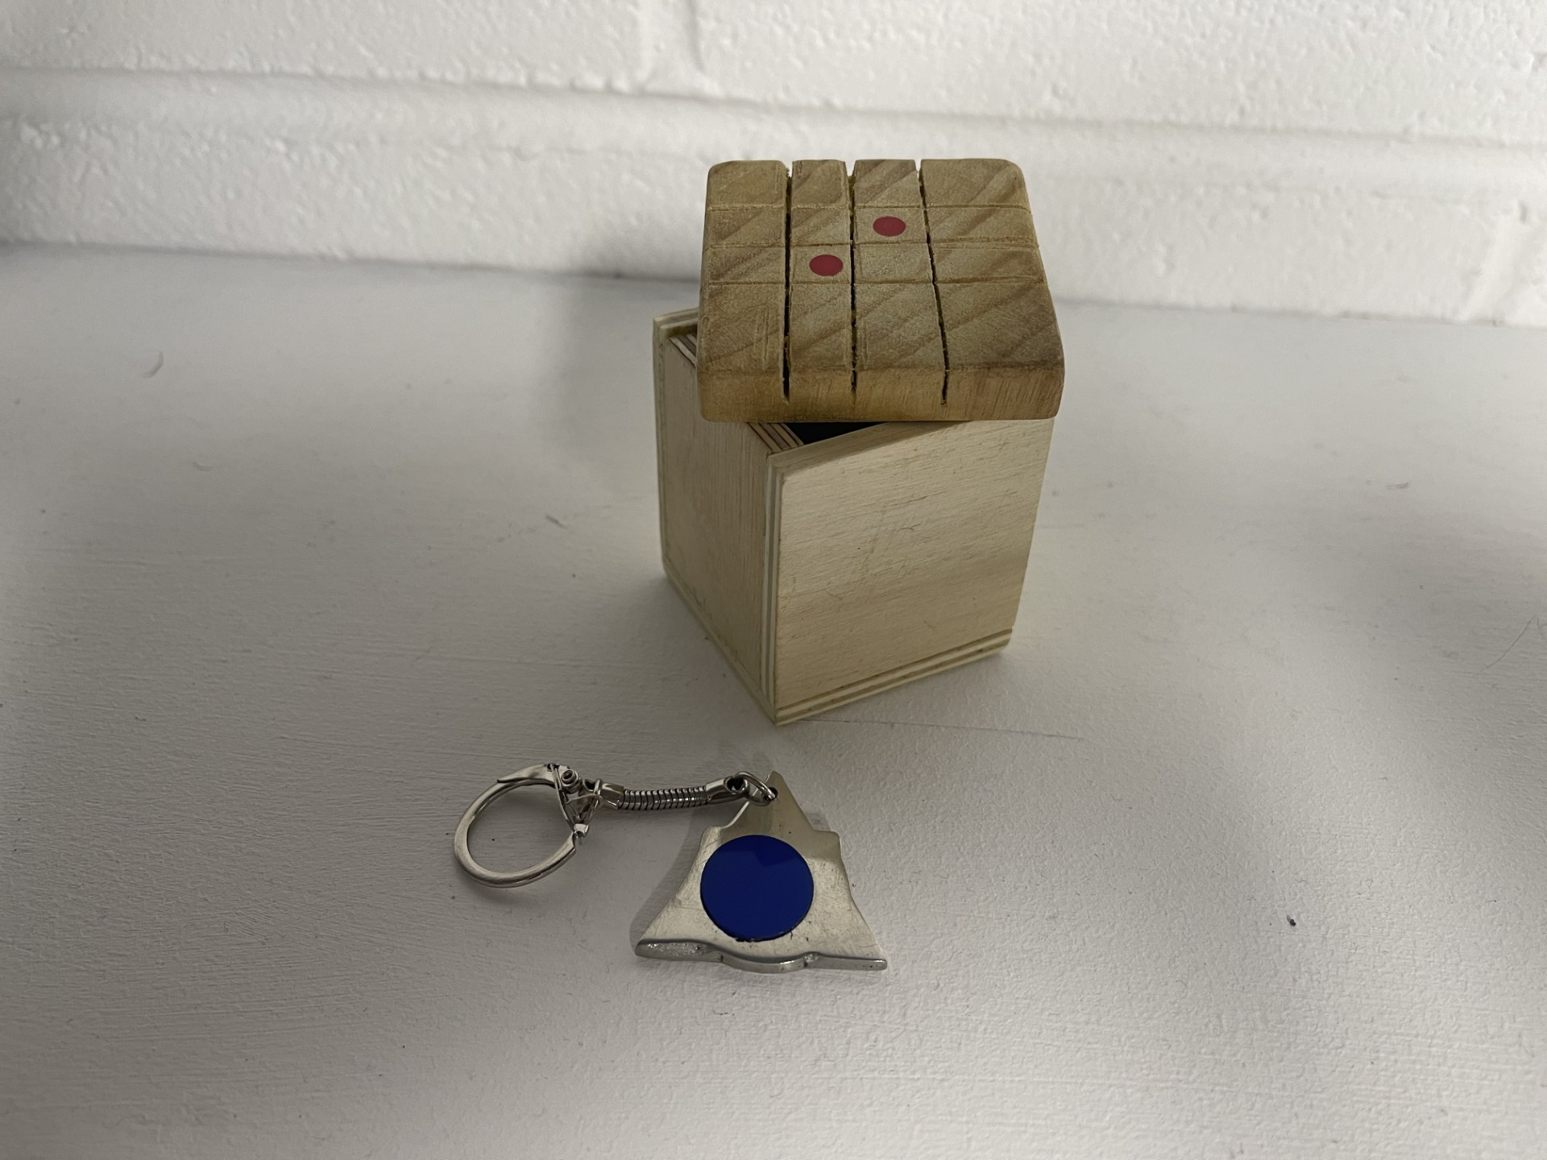
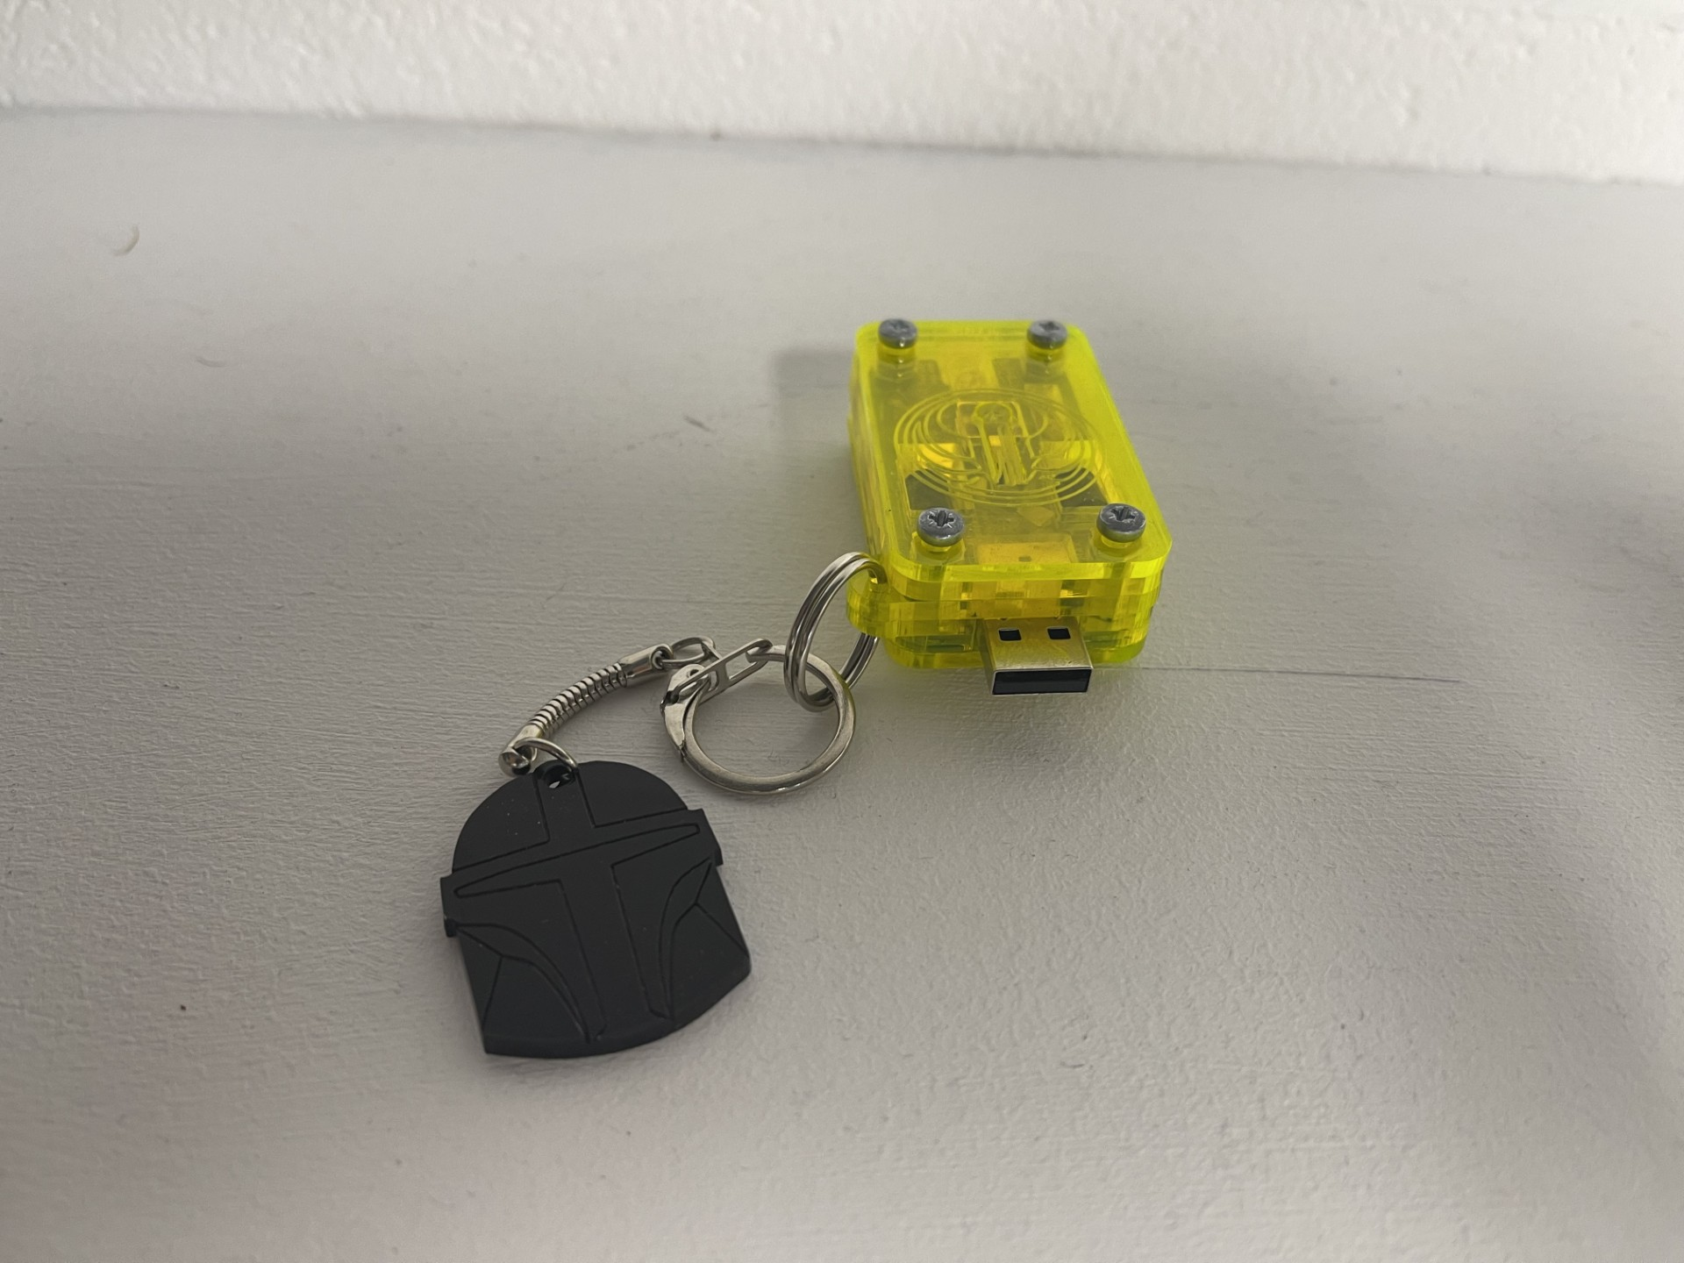

What is Resistant Materials?
Woods
Metals
Polymers (Plastic)
Smart Materials
CAD/CAM
Industrial Practices

Slide 3
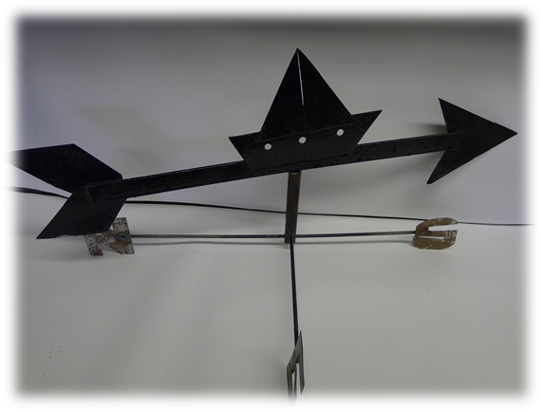
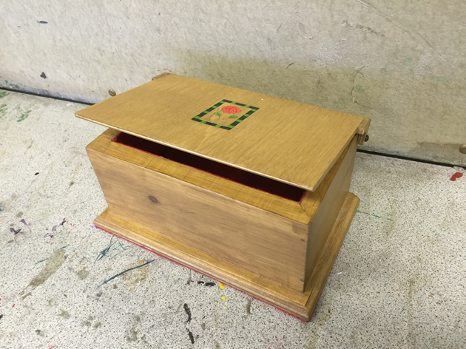
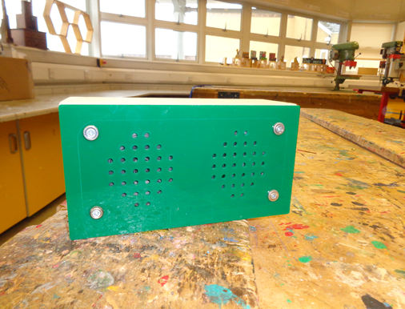

Year 10 Projects
Weathervane Metal Work project
Storage Solution
MP3 Speakers
Art Deco Clock (Pre GCSE)

Slide 4
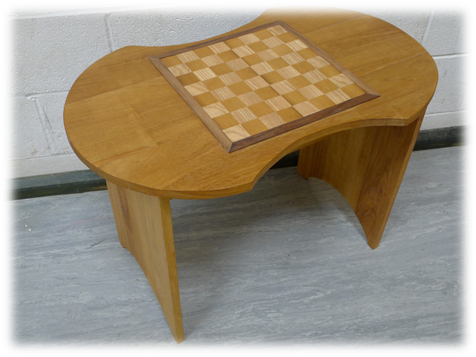
Year 11 Major Project (NEA)
Non Exam Assessment
In June of Y10 AQA will set three context (problems) for you to choose from as your Major Project.
Your project will consist of a folder covering the following areas:
Research
Specifications
Design Ideas
Development Work
Evaluation
Having designed and developed a solution you will then product a final practical working prototype.

Slide 5
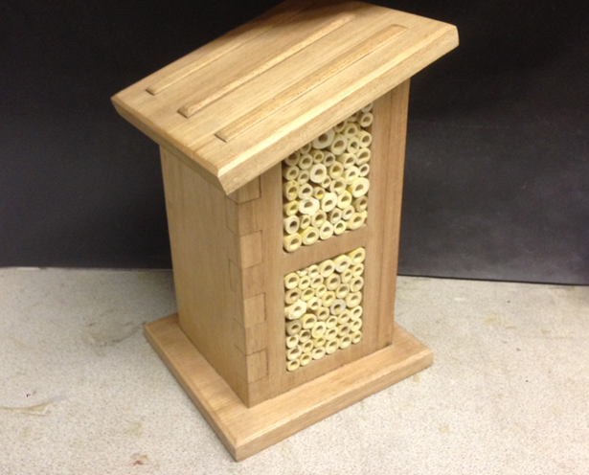
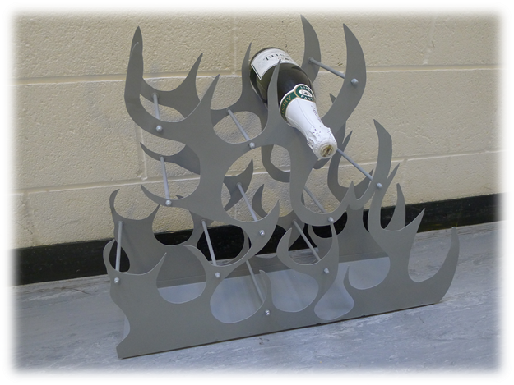
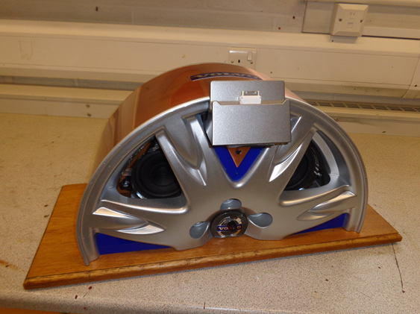
Year 11 Major Project (NEA)
Non Exam Assessment
In June of Y10 AQA will set three context (problems) for you to choose from as your Major Project.
Having designed and developed a solution you will then product a final practical working prototype.

