Slide 1

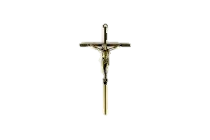



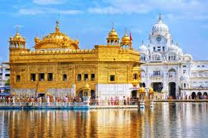


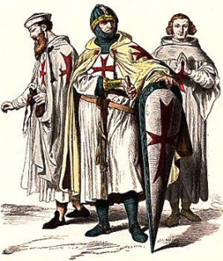



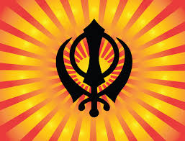
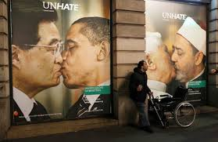


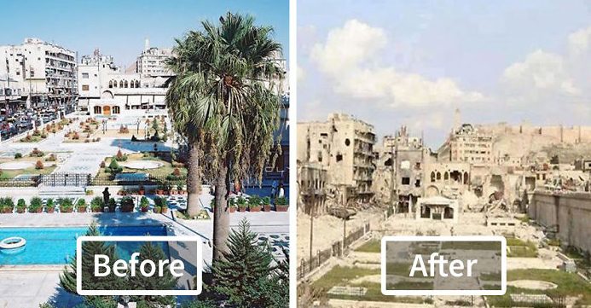

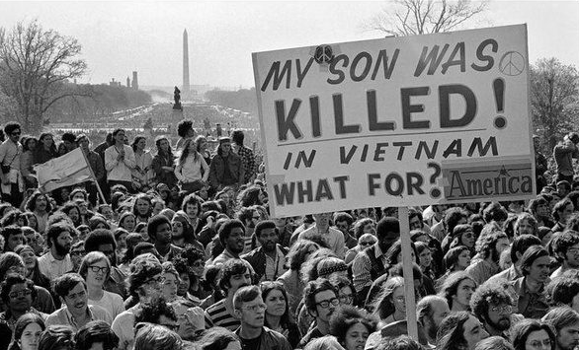




GCSE Religious Studies

Slide 2

Who is GCSE RS FOR?
Respect for
difference
and tolerance
To dig below
the surface
of human
existence
For those who
ask questions
Relevant to the
world today

Slide 3
So what have students said about RS
‘ It’s a subject where my opinion really matters’
‘I met so many different people and had experiences I will never forget’
‘I loved dressing up when the Sikh lady came in, we all got henna drawings it was great’
‘We never know what were doing next…one lesson its role play, the next debate, then some writing. That’s what makes it really exciting’

Slide 4

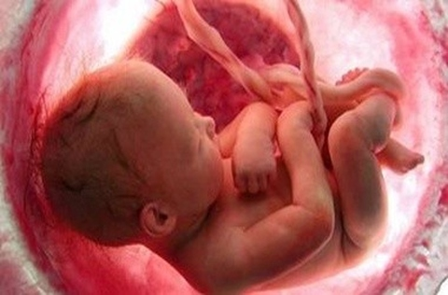
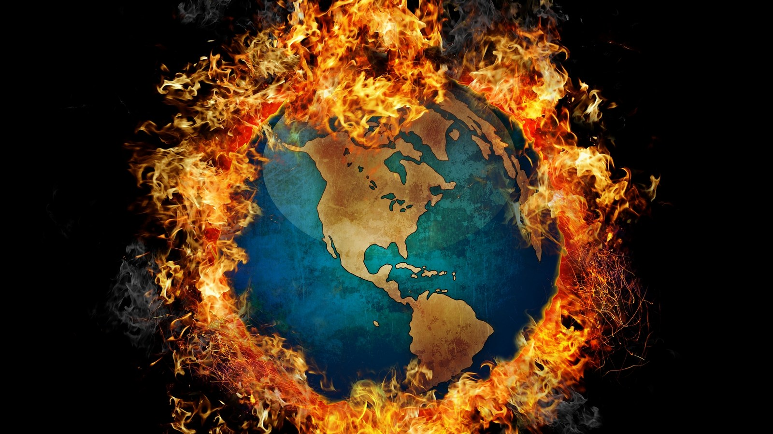
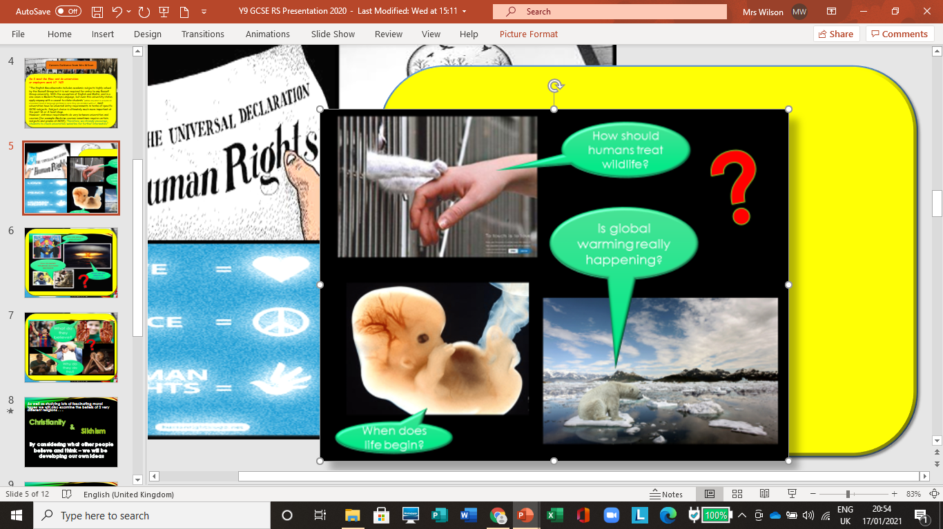
When does life begin?
How should humans treat wildlife?
Is Global Warming really happening?
This Photo by Unknown Author is licensed under CC BY

Slide 5
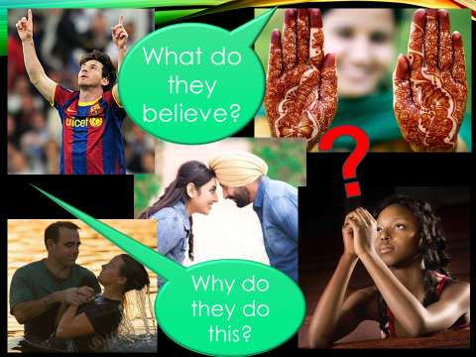

Slide 6
As well as studying lots of fascinating moral issues we will also examine the beliefs of 2 very different religions . . .
Christianity
&
Sikhism
By considering what other people
believe and think – we will be
developing our own ideas

Slide 7
Christianity
&
Sikhism
Having faith?
How did they start?
Make a pilgrimage
What kind of God?
Holy places
Festivals celebrations
How do these religions approach issues?

Slide 8


Jobs
Skills
All jobs!!! Whether you want to be a builder or a doctor or a high flying lawyer!
GCSE RS teaches you how to work with others, think about difficult questions and understand the world you live in!
GCSE RS is all about people. In every walk of life you will encounter people!
Research
Empathy
Listening
Communication
Debating
Questioning
Analysing
Weighing up arguments
What is it useful for?

Slide 9


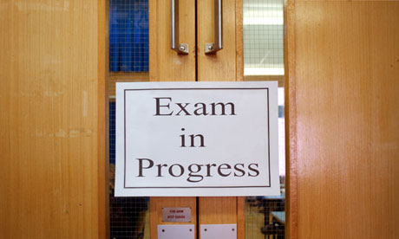

Expectations
A willingness to try your hardest
Not being afraid to have an opinion and question others
Enthusiasm for the subject
To come with an open mind
Important information
Assessment
Two 1 hour and 45 minutes exam at the end of Year 11
The exam board is AQA, (Spec A)
Exam Board

