Slide 1

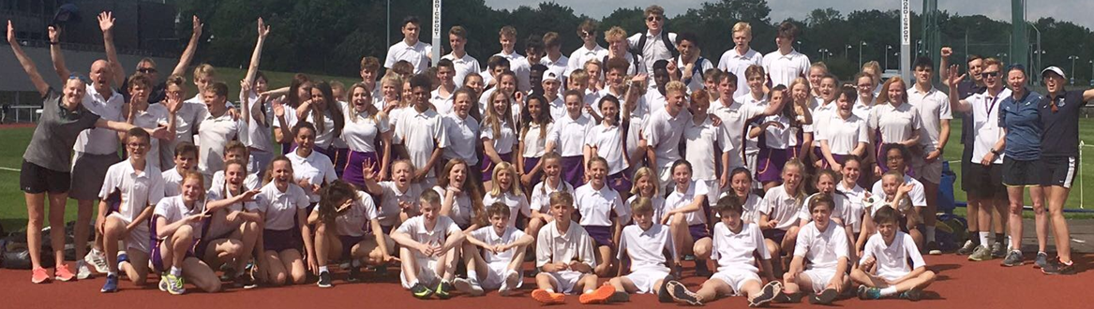


KS4 PHYSICAL EDUCATION
2025-2027

Slide 2
Why should you choose Physical Education?
There are many reasons why Physical Education may be the course for you……
If you are passionate about sport and physical activity.
If you have really enjoyed PE lessons and extra-curricular sports clubs at Sheldon.
If you are considering A-Level PE, a degree or a career in sport.
If you are looking for a subject to complement your other options and to help you lead a healthy and active lifestyle.

Slide 3
At Sheldon we offer two examination PE courses
2. Cambridge National Level two in Sports Studies
1. GCSE Physical Education
If students perform well on either course they can access A-Level Physical Education at KS5.
Sports courses at University

Slide 4
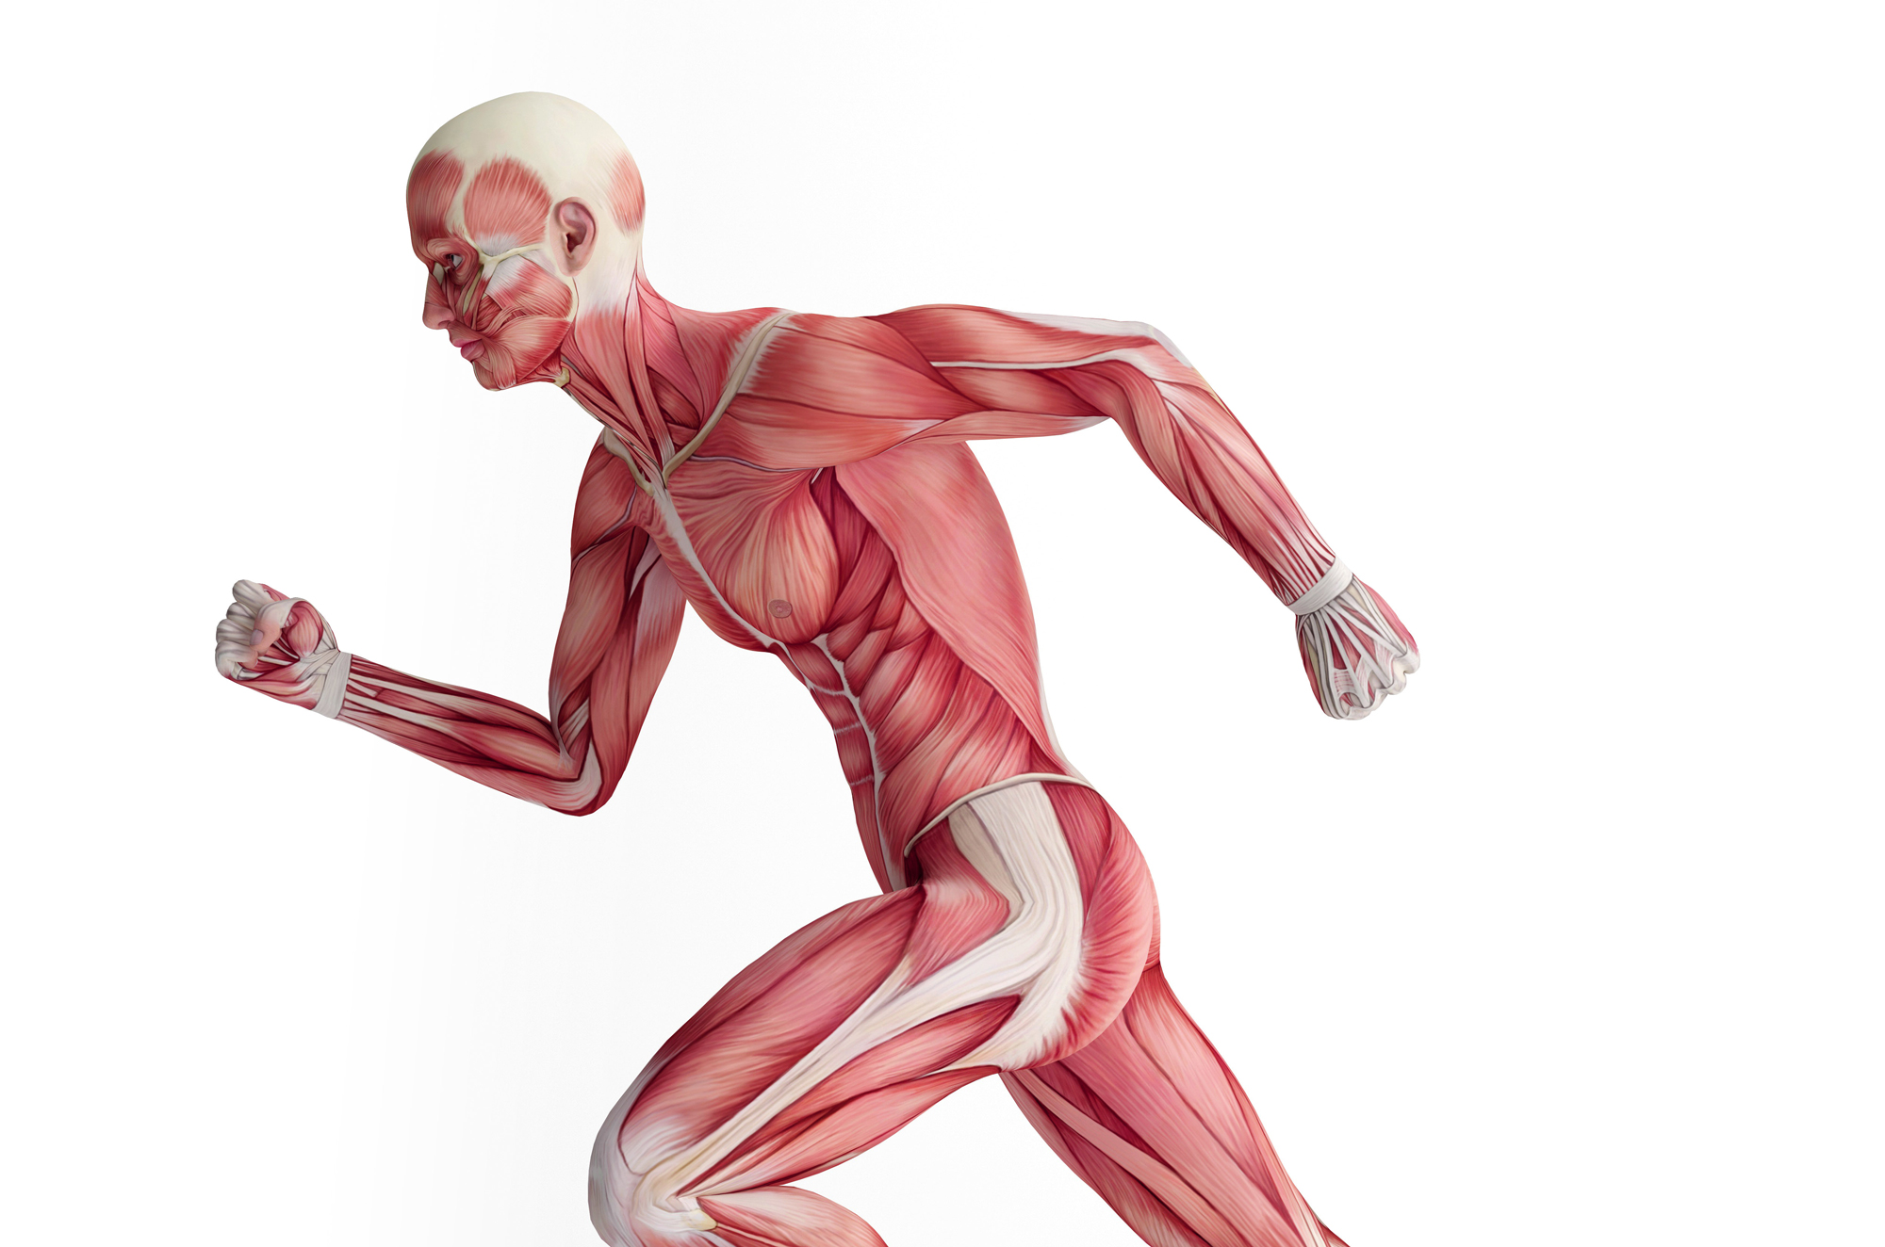
1. GCSE Physical Education
The GCSE PE course is 60% theory, 10% coursework and 30% practical
THEORY
Bones, muscles and joints
Cardiovascular and respiratory systems
Topics covered
Anatomy and Physiology
Movement Analysis
Physical Training
Sports Psychology
Social and Cultural Influences
Health, Fitness and Well being
Movement analysis
Training methods
Barriers to participation
Fitness components
Aggression in sport
Hooliganism
Drugs in sport
Sport and the media
Ethical issues in sport
Health and fitness
Sponsorship in sport
The theory is assessed by two exams (78 marks) at the end of the course. Questions are either multiple choice, short or longer mark questions.
Diet and nutrition
Social groups and their impact on sport
Technology in sport

Slide 5
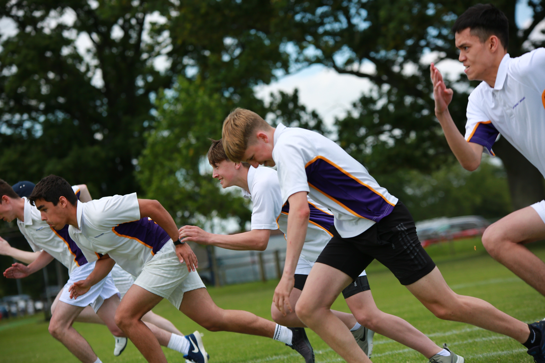
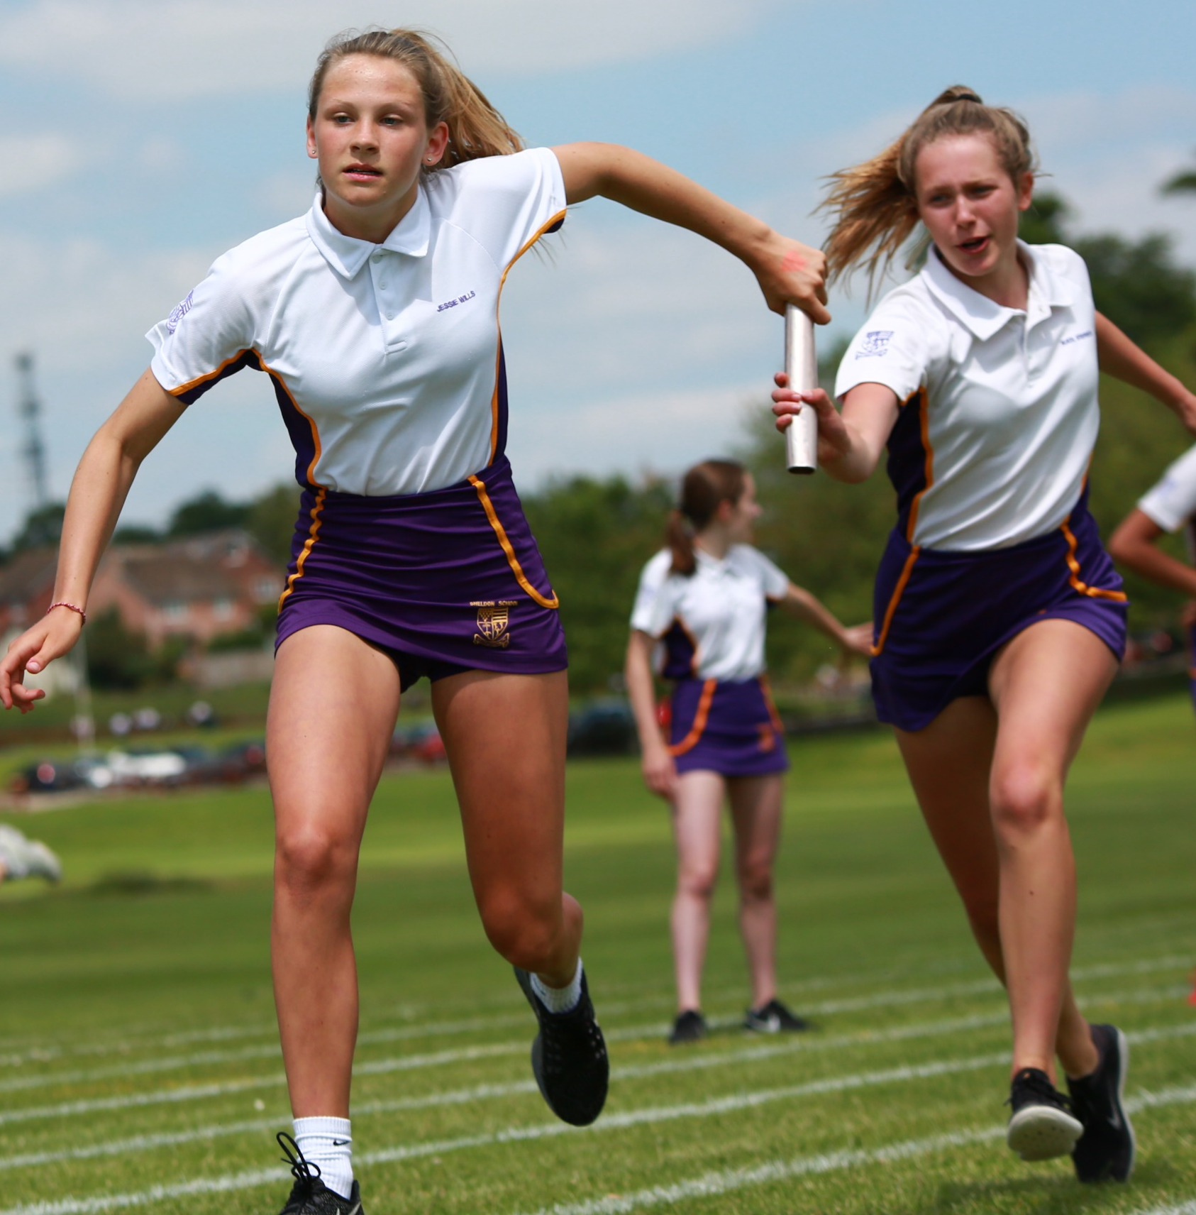
1. GCSE Physical Education
PRACTICAL
You choose three sports to be assessed in.
This must be: one individual sport and two team sports OR two individual sports and one team sport.
Click here and scroll down to P46 for a list of GCSE sports you can be assessed in.
In practical GCSE PE lessons we cover the following sports over the two year course:
-Football -Netball
-Hockey -Rugby
-Basketball -Badminton
-Table tennis -Athletics
-Cricket -Tennis
If your strengths lie in a sport other than those mentioned above we will come and watch you perform at your local club.
The practical element is assessed during GCSE PE lessons and at clubs and fixtures. We also do off site assessments for sports such as horse riding.

Slide 6
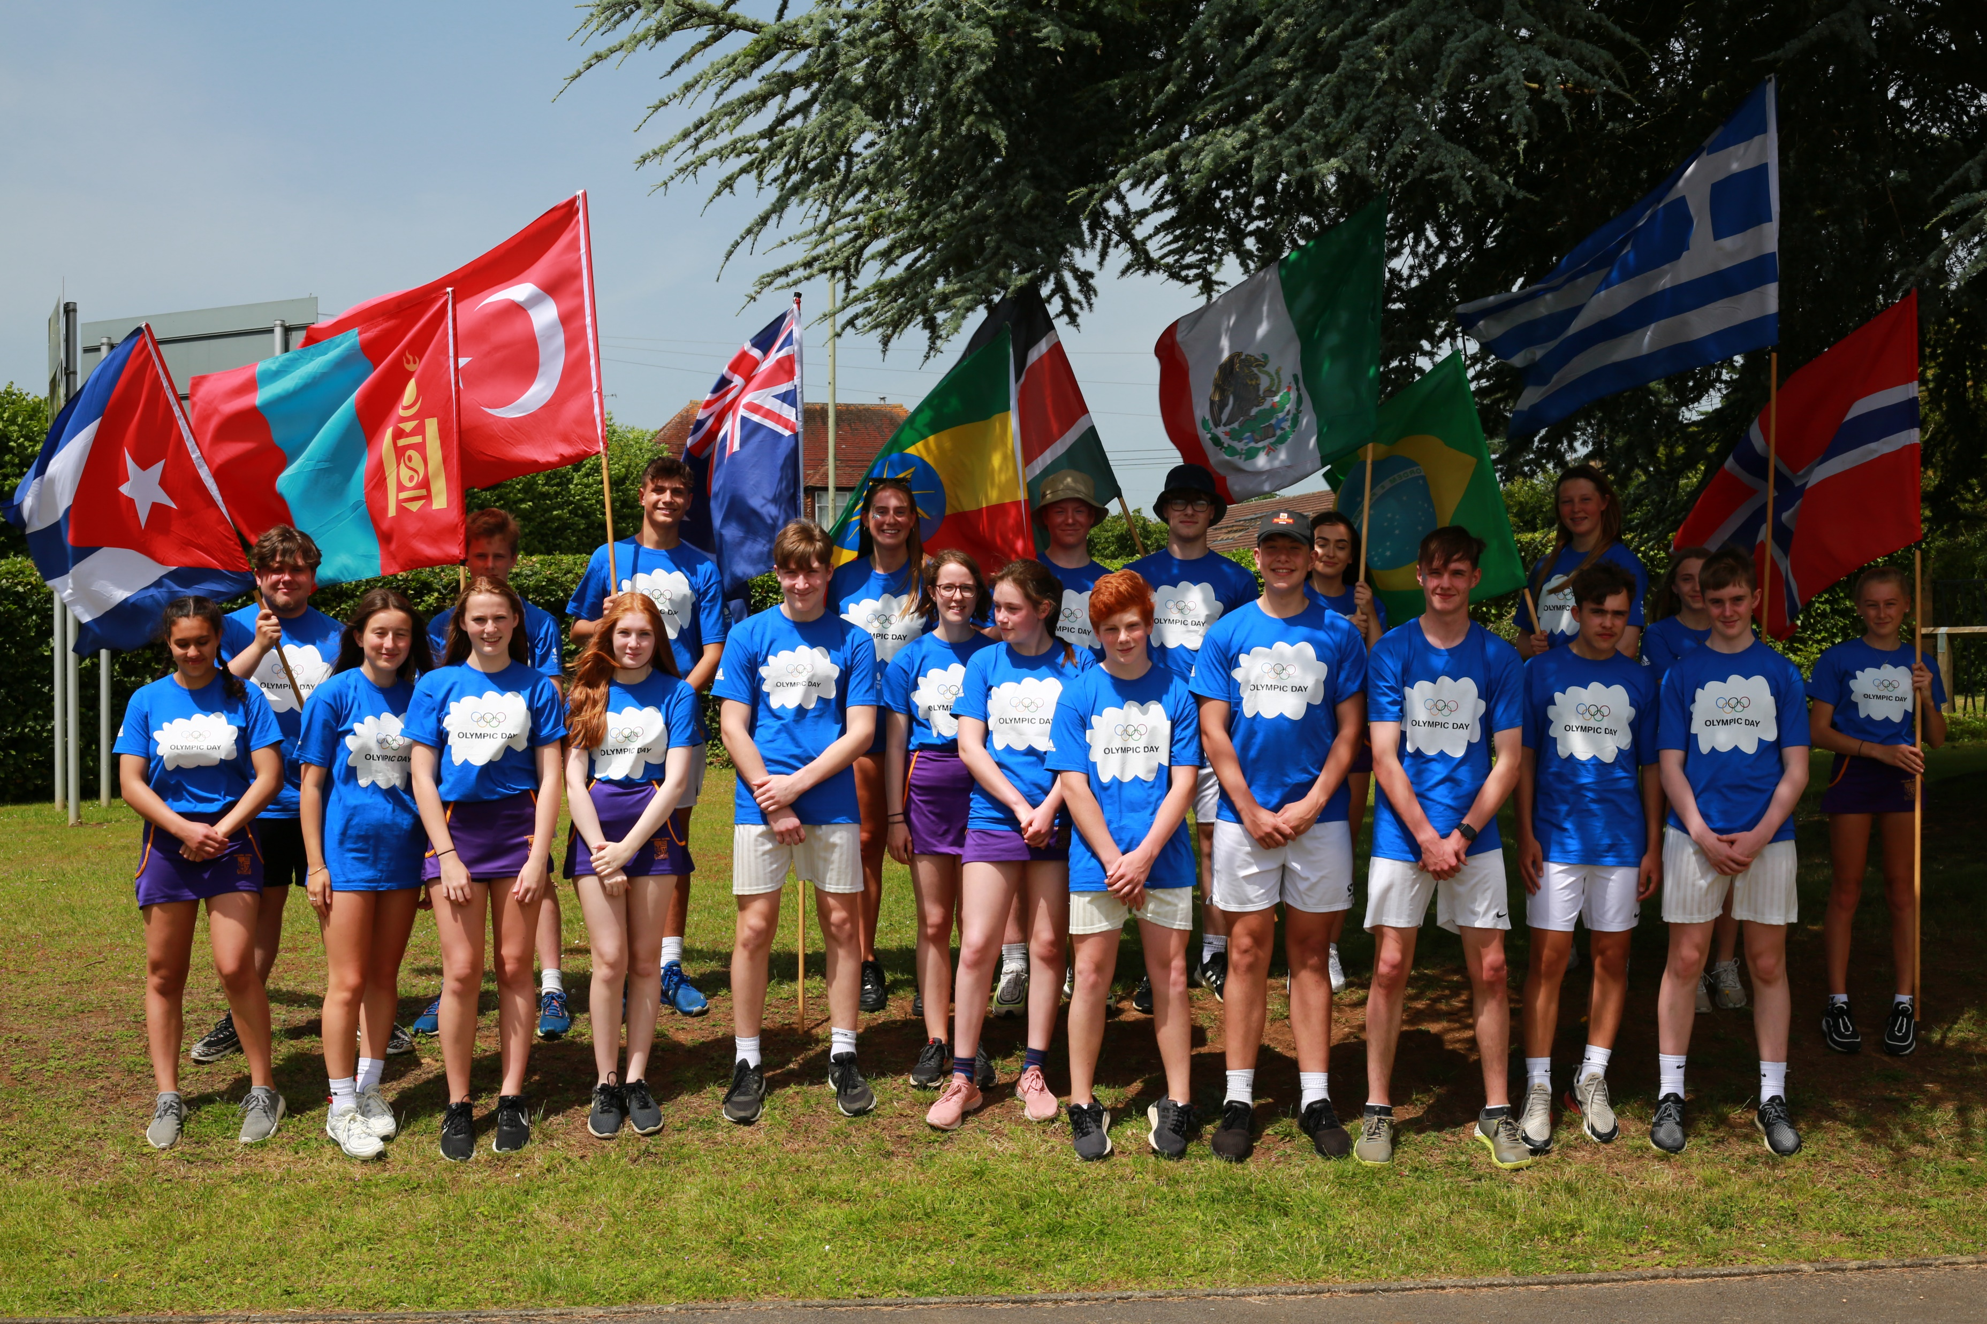
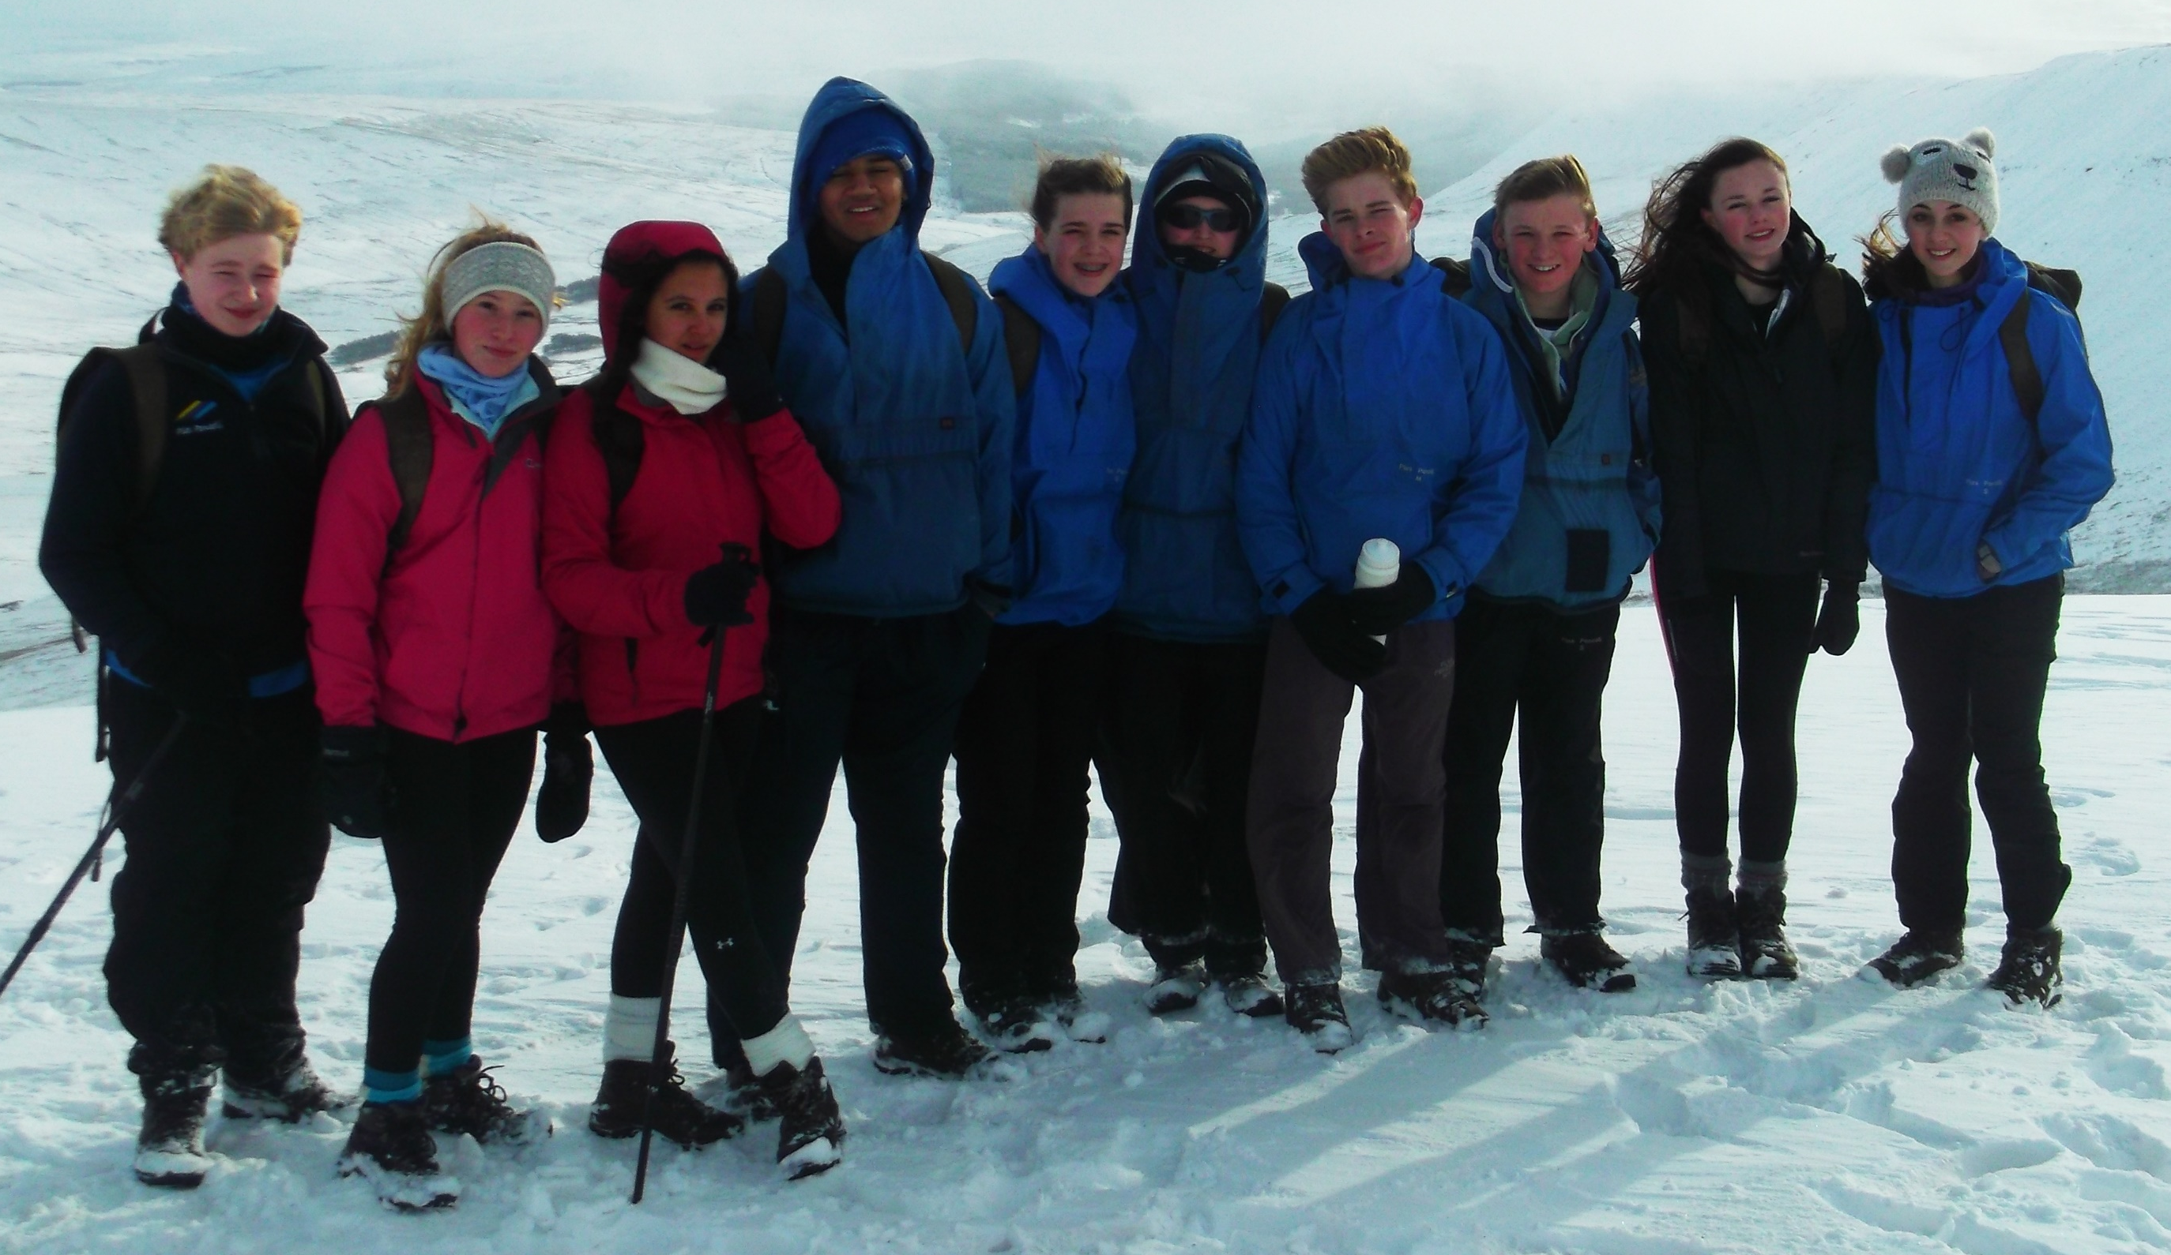
2. Cambridge National Level Two in Sports Studies
3 Units over two years
Unit | Module | How is this module assessed?
Unit 1 | Contemporary Issues | External exam (40%)
Topics covered include:
Sporting etiquette
Funding in sport
Barriers affecting participation across different social groups
National Governing Bodies
Drugs in sport
Hosting international events (Olympic Games/ World cup)
Technology in sport
Unit | Module | How is this module assessed?
Unit 2 | Performance in sports activities and leadership. | Teacher assessed practical skills and coursework which is then moderated (30%)
Practical performance in a team and individual sport
Leadership roles and responsibilities
Leadership styles
Planning and delivering a sports sessions to younger students

Slide 7
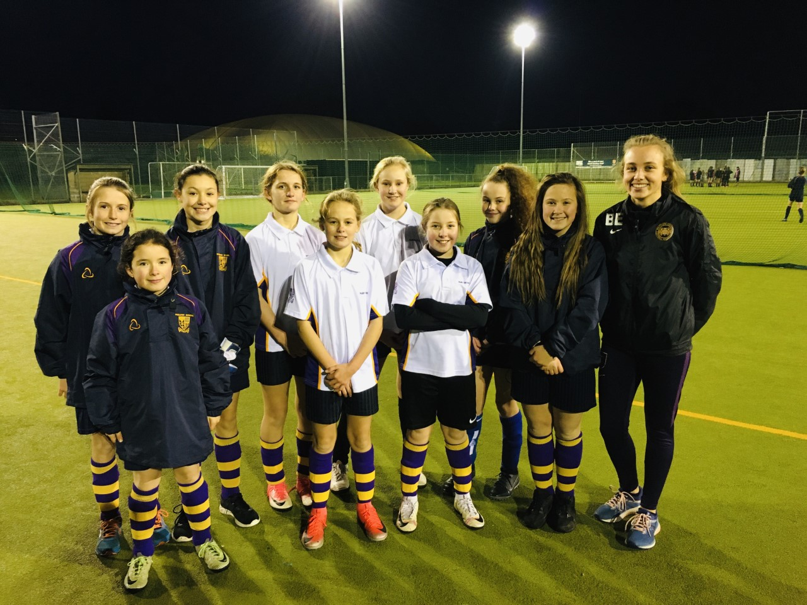
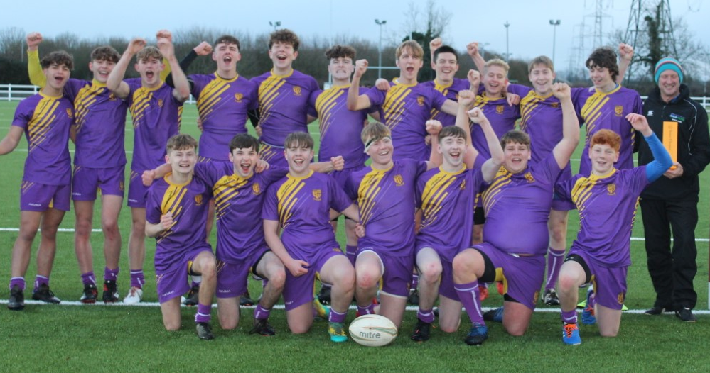
Unit | Module | How is this module assessed?
Unit 3 | Outdoor Pursuits | Teacher assessed coursework which is then moderated. (30%)
GRADINGS
-L2 Distinction *
-L2 Distinction
-L2 Merit
-L2 Pass
-L1 Distinction
-L1 Merit
-L1 Pass

Slide 8
Opting into GCSE PE or Cambridge National PE is the first step on the ladder to a career in sport.
Here are a few of the possible careers in sport:
PE teacher
Sports physiotherapist
Sports lawyer
Sports journalist
Professional athlete
Sports scientist
Sports development officer
Sports photographer
Sports coaching
Sports therapy
Sports masseuse
Sport and the leisure industry
Sports marketing
Personal trainer
Sports rehabilitation

Slide 9
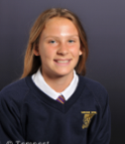
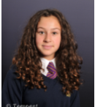
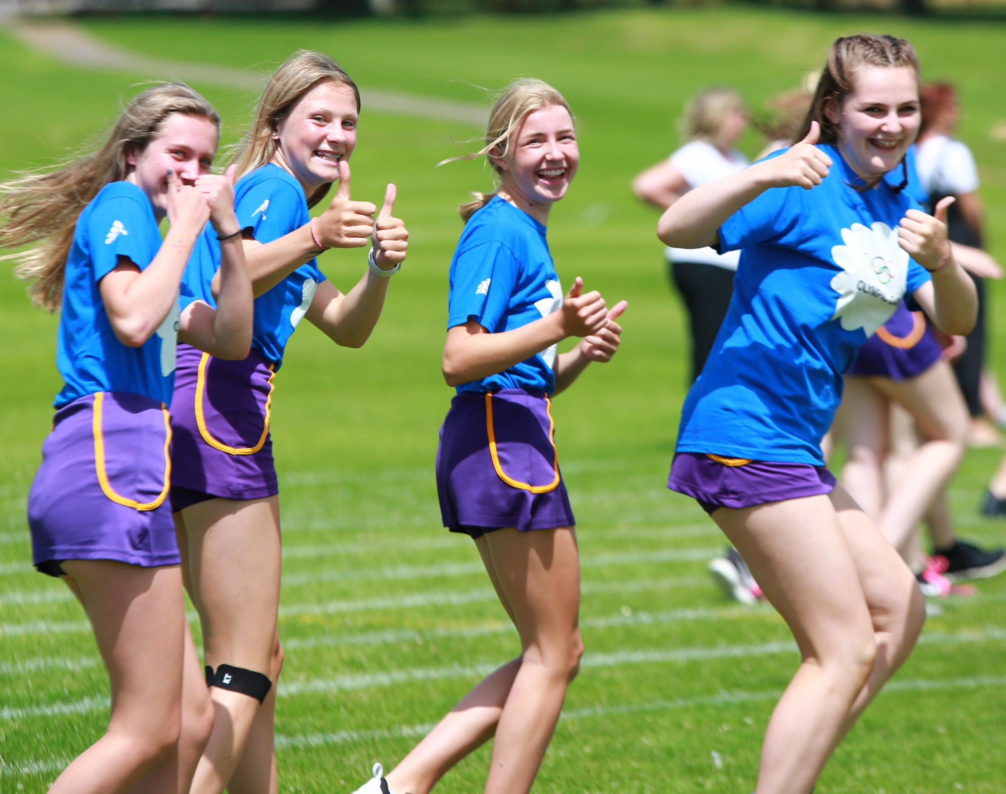
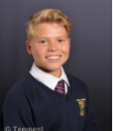
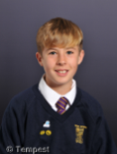
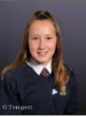
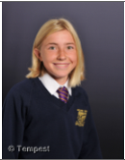
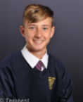
I love GCSE PE it is my favourite subject, I enjoy both the theory which links to my other subjects such as Biology and I love the physical side of the lessons too as you get to play your favourite sports at a higher level.
I really love GCSE examination PE not only for the practical side of it but also the theory. The lessons are enjoyable, organised and everything is super fascinating to learn.
I would really recommend the Cambridge course. There is only one exam and the rest is course work, and for me personally I prefer course work.
I find the theory part really interesting and because I love playing sport I really enjoy all of the practical lessons.
I enjoy GCSE PE because I love sport and it is a great opportunity to be surrounded by other people that also enjoy sport, it allows you to learn about different aspects of sport that you didn't know were a part of the game!
I enjoy GCSE PE as it gives you the opportunity to take part in a variety of sports as well as learning more about the theory of sport and exercise.
I chose Cambridge PE because I didn’t like the fact that in GCSE PE you had to do a big exam at the end in year 11. With Cambridge you only do a small exam at the start. Also it’s a lot more practical based and I really like that.

