Slide 1
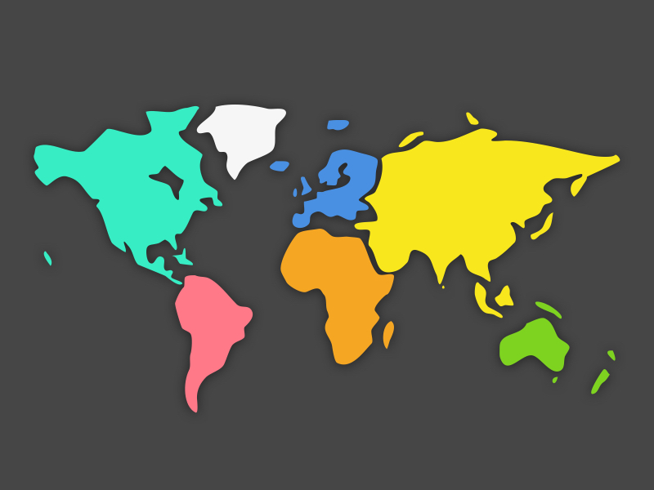
Why study GCSE geography?

Slide 2
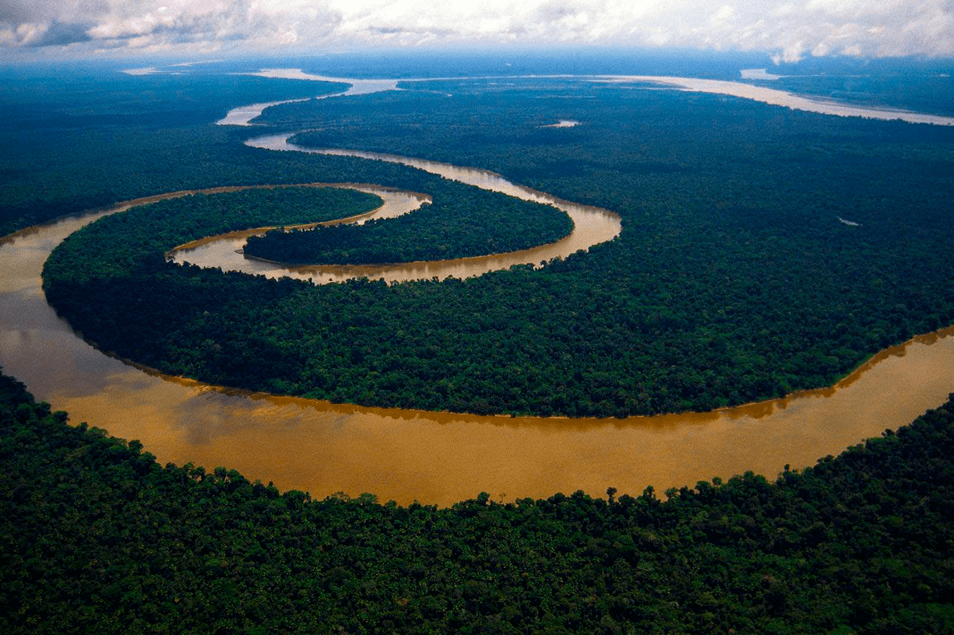
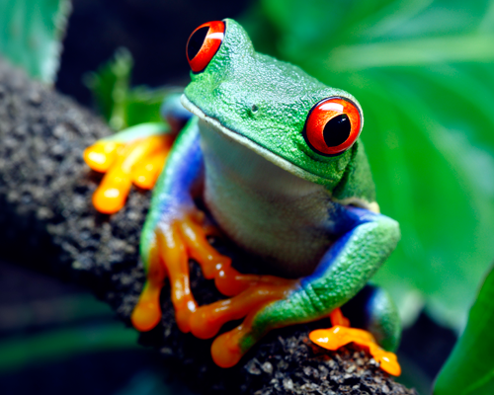
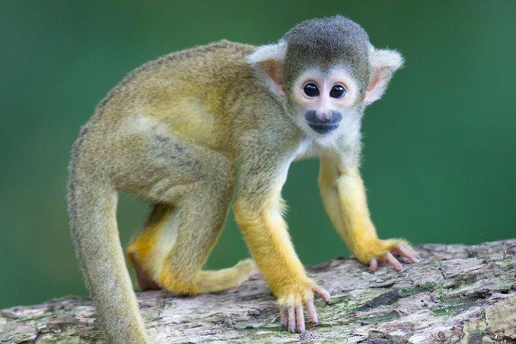
We visit places without leaving the classroom
Notes:
When a good geographer looks carefully they can see the smallest detail in the biggest pictures.

Slide 3
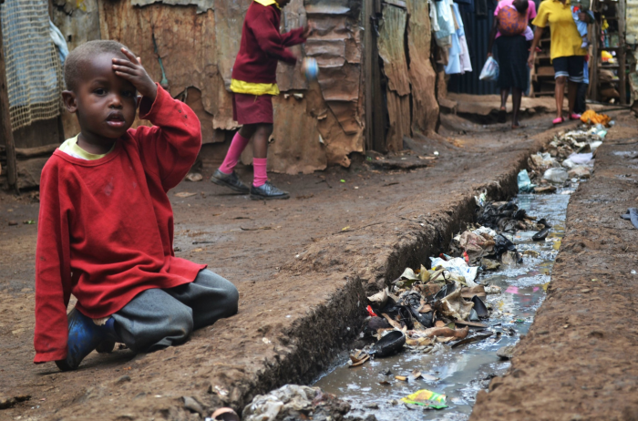
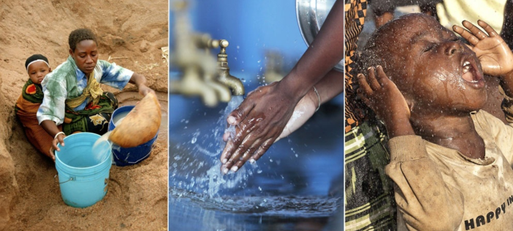
We learn about challenges facing urban populations
How can we make sure everyone has
access to safe drinking water?
Notes:
UK and overseas, there are large numbers of people living in towns and cities.
Their experiences within and between countries is not the same – why? How can we reach better equality?

Slide 4
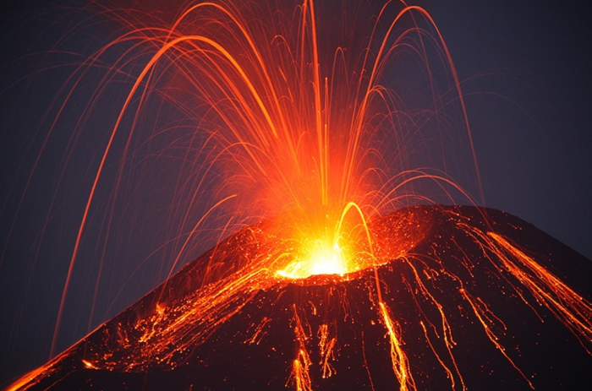
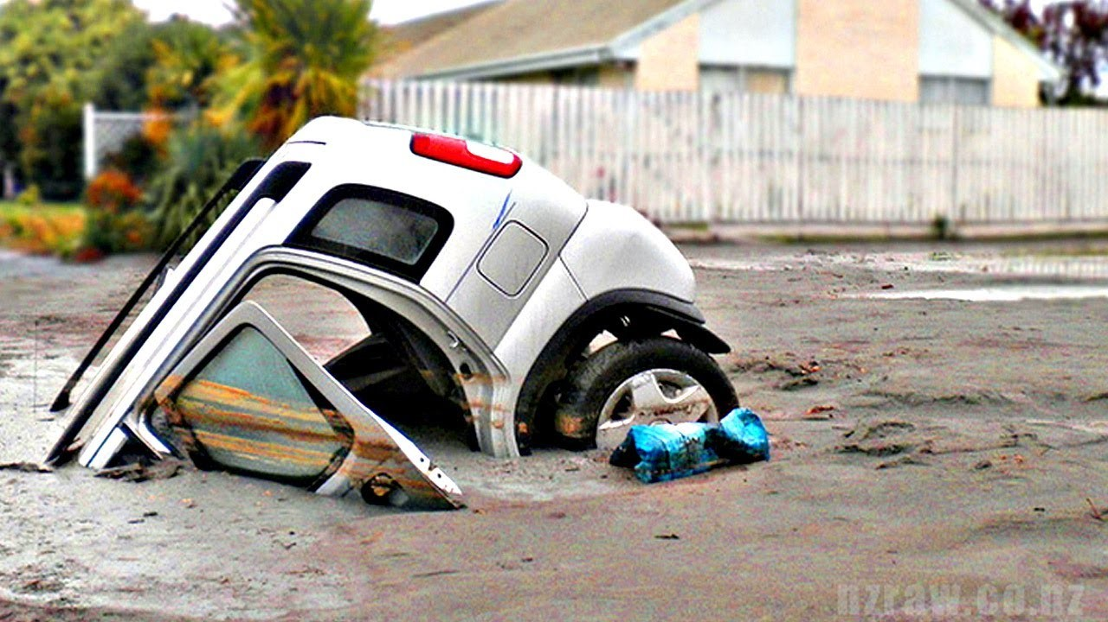
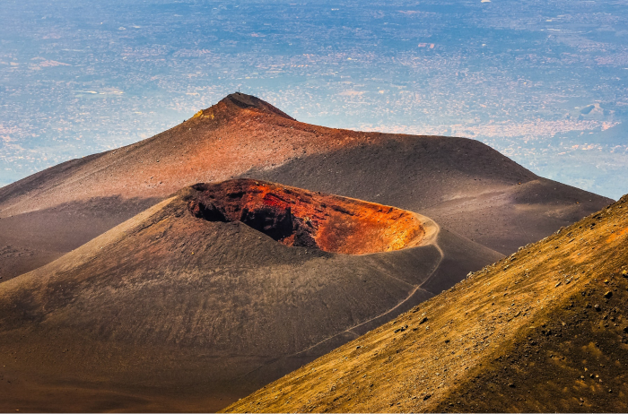
We learn about the processes beneath our feet
Notes:
Why volcanoes erupt (we may even visit one!) – the beauty and the destruction of these events
The impacts of earthquakes – we may be familiar with the idea that the shaking earth can topple a building, but how does a parked car end up looking like this?

Slide 5
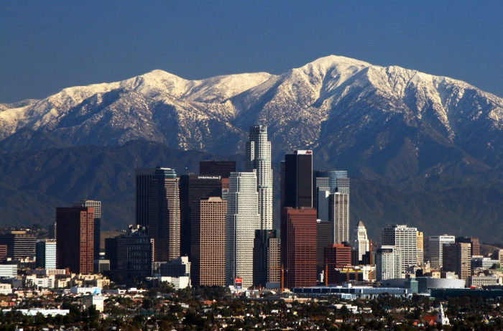
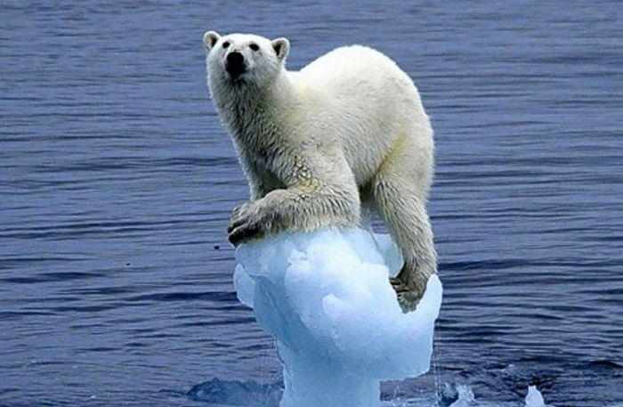
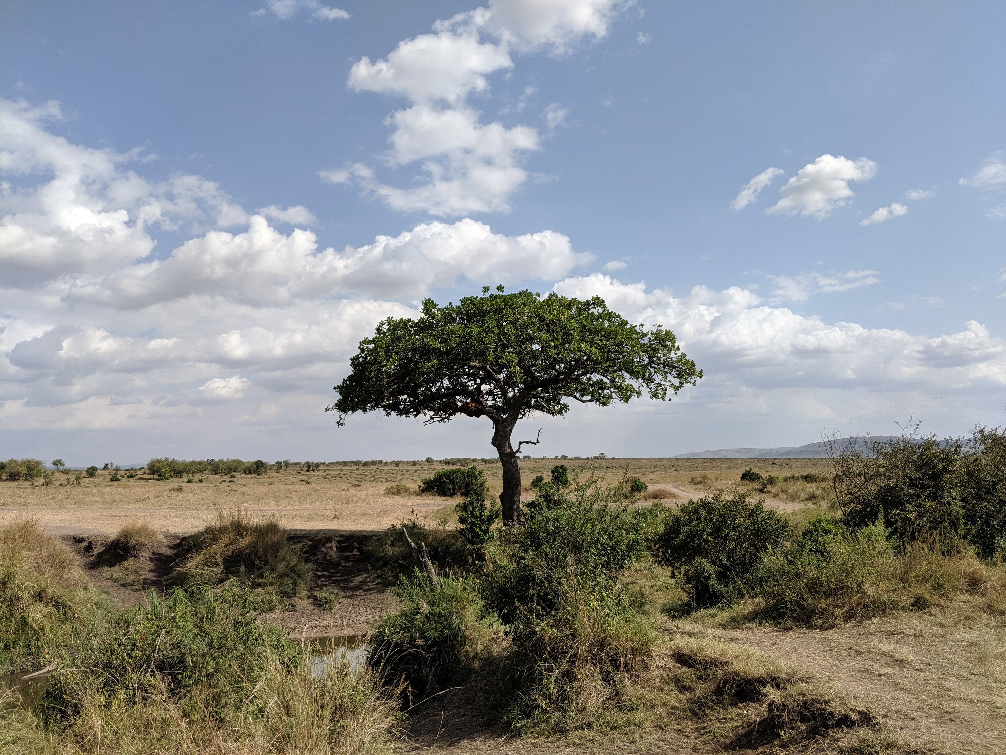
Geography is about the natural world and so much more…
Notes:
It is about how people interact with their surroundings
And understanding the impact of people on the natural world

Slide 6
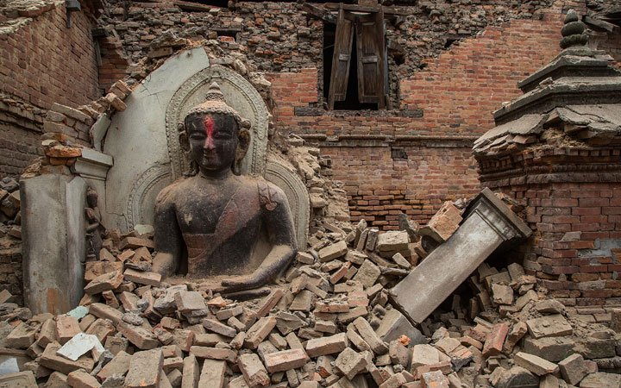
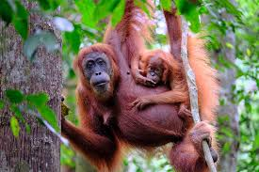
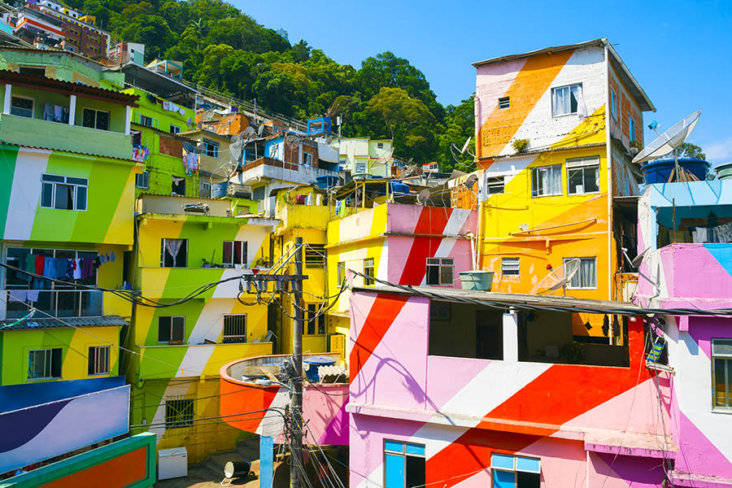
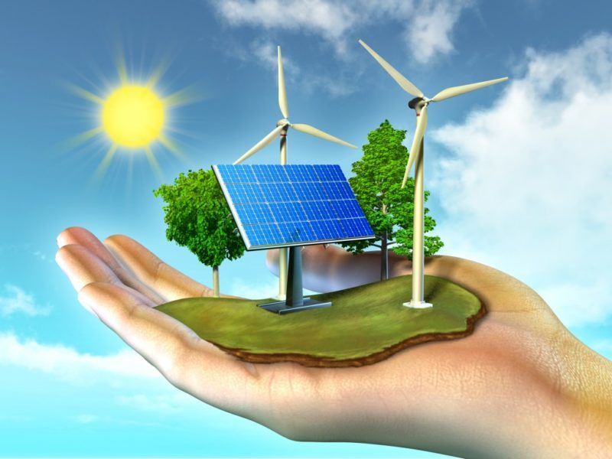
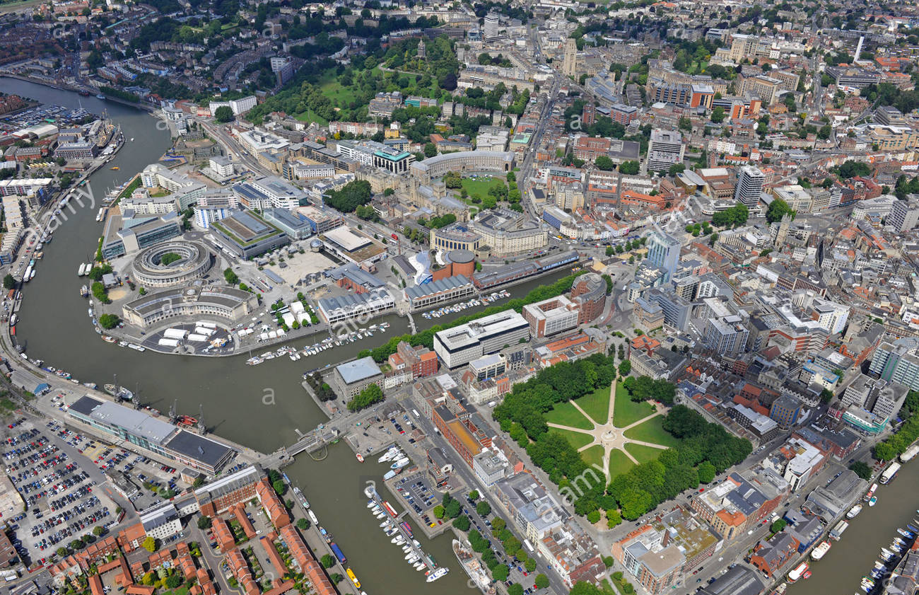
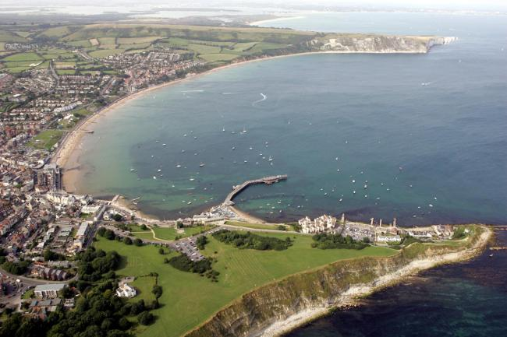
What topics will you study?
Paper 1: The Physical Environment
Hazards, Ecosystems, UK Landscapes
Paper 2: The Human Environment
Urban, Economic, Resources
Paper 3: Geographical Applications
Fieldwork, Problem Solving

Slide 7
What skills will you develop?
Up-to-date knowledge
Place knowledge
Issue analysis
Fieldwork
Mapwork
Data manipulation
Geographical argument
Notes:
Steal the transferable skills bit from here https://www.rgs.org/CMSPages/GetFile.aspx?nodeguid=384762cd-5fd8-4c6b-9d8e-f1b426cc6bc2&lang=en-GB

Slide 8






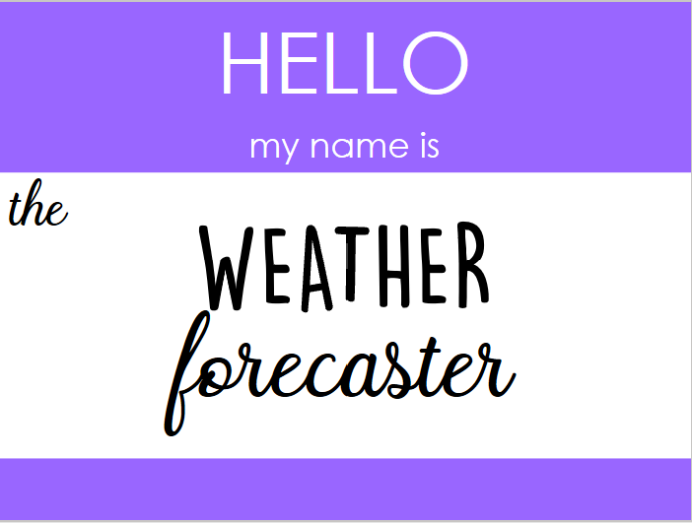

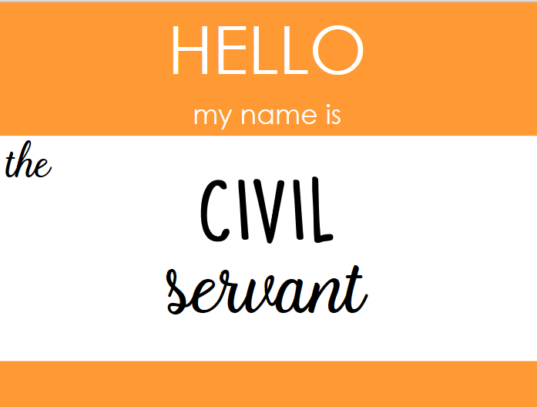





Where will geography take me?

Slide 9
What do our students say?
Its relevant to everyday life and you cover a wide range of things.
Supports other subjects, eg climate change & biomass in science.
Every lesson is different, interesting and enjoyable.
It has a wide range of topics so can be useful to many potential jobs in the future.
Work on 6 and 9 mark answers helps for other subjects too.
It covers skills that I can use in other lessons as well.
Love learning about the age-old processes affecting the very ground we stand on.
We look at what is happening right now in different places.

Slide 10
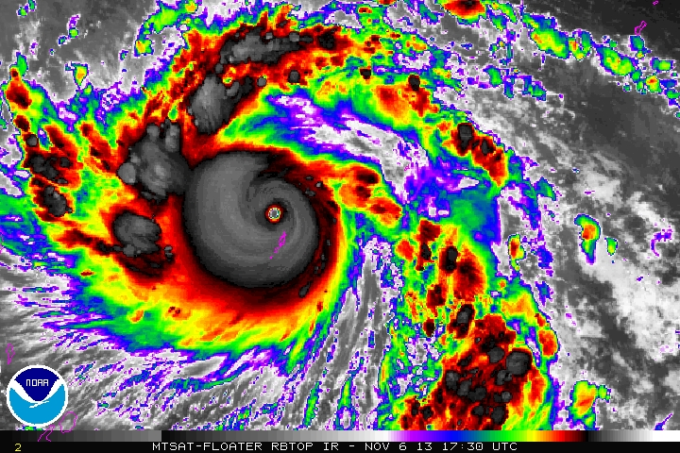
Typhoon Haiyan
Monday, 06 January 2025
Aim: to assess the impacts of tropical storms

Slide 11
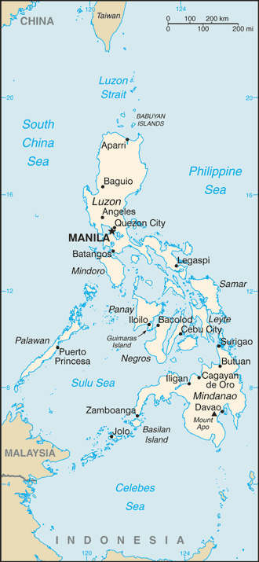
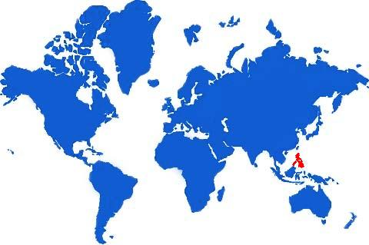
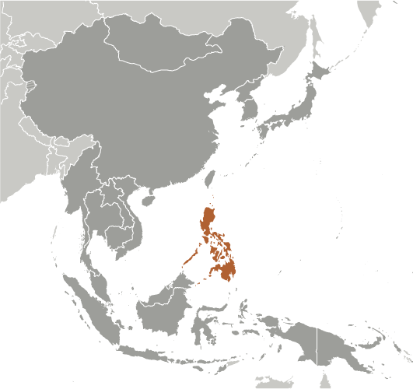
Where is the Philippines?

Slide 12
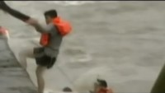
What happened during the storm?

Slide 13
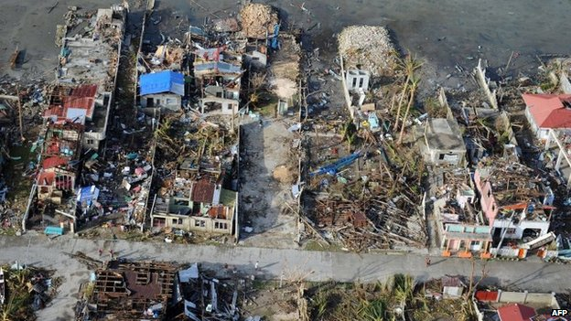
What impact is the storm having?
People have lost their homes. This is a problem because they do not have safe shelter to protect them from the weather.

Slide 14
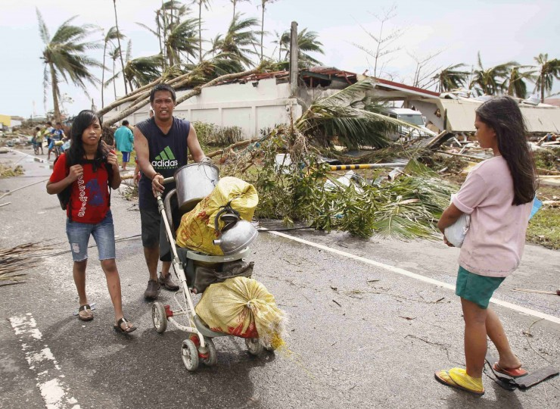
What impact is the storm having?
People have lost personal belongings. This is a problem because…

Slide 15
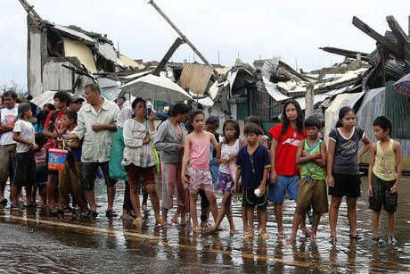
What impact is the storm having?
People do not have safe drinking water or food. This is a problem because…

Slide 16
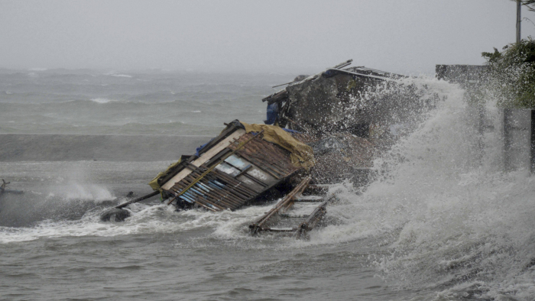
What impact is the storm having?
Flooding is happening at the coast. This is a problem because…

Slide 17


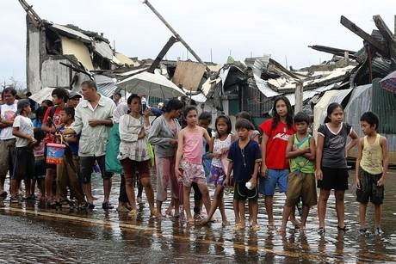
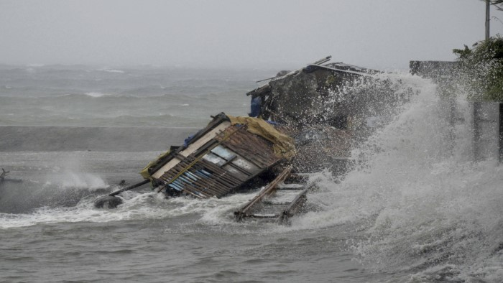
What impact is the storm having?

Slide 18
Which of the four impacts is the worst? Why?

Slide 19
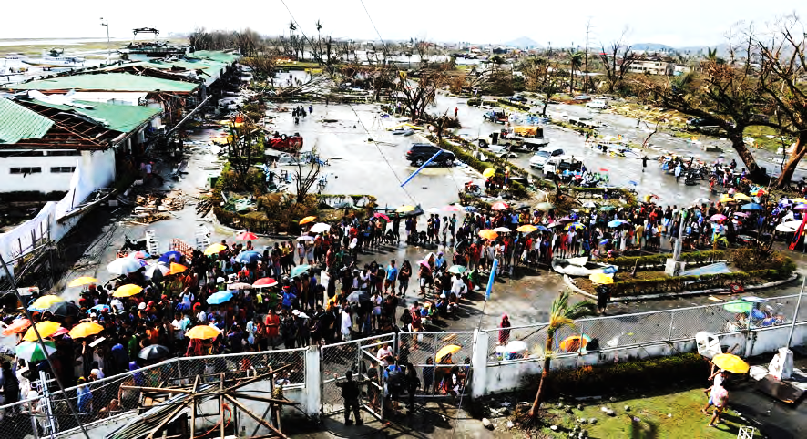
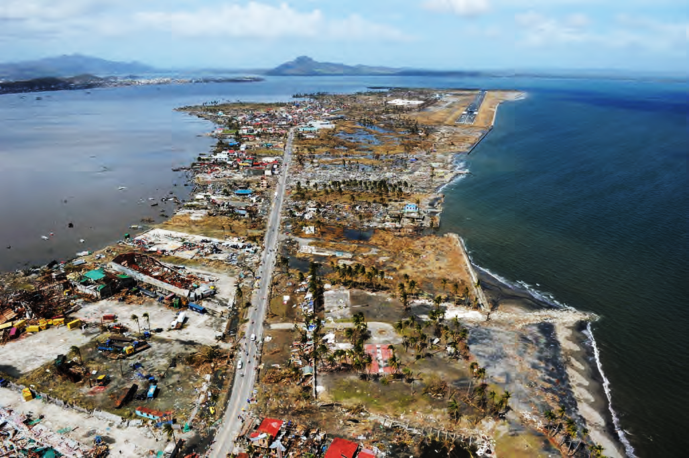
9a
Tacloban Airport
Photographs taken after the Philippines were hit by Typhoon Haiyan on 8 November 2013.
Describe the effects of Typhoon Haiyan shown in Figures 9a and 9b.
(4)
9b
Tacloban coast near the airport

