Slide 1
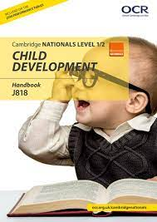
Cambridge Nationals Level 1 / 2: Child Development
You may be interested in this if you want an engaging qualification where you will use your learning in practical, real-life situations, such as: • preparing a feed or meal for a child • choosing suitable equipment to use in a childcare setting • planning suitable play activities • helping to prevent accidents in a childcare setting.

Slide 2
Course structure
Three Mandatory Units:
Health and well-being for child development
Creating a safe environment and understand the nutritional needs of children from birth to five years
Understand the development of a child from one to five years.

Slide 3
Assessment
One written paper, set and marked by the exam board. 1hour 15mins. Health and well-being for child development
Centre assessed coursework -
Creating a safe environment and understand the nutritional needs of children from birth to five years
Understand the development of a child from one to five years

Slide 4
Health and well-being for child development
In this unit, students will learn about the importance of both pre-conception health and creating conditions in which a child can thrive, including the prevention and management of childhood illnesses and creating a safe environment.

Slide 5
Creating a safe environment and understand the nutritional needs of children from birth to five years
In this unit, students will learn how to create a safe environment for children from birth to five years in childcare settings. They will investigate and choose equipment that is both suitable and safe for use and will learn about their nutrition and dietary needs.

Slide 6
Health and well-being for child development
In this unit, students will learn about the importance of both pre-conception health and creating conditions in which a child can thrive, including the prevention and management of childhood illnesses and creating a safe environment.

Slide 7
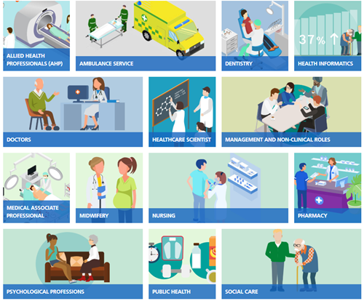
Who would enjoy and be successful on the course?
This course will be suitable for students who are interested in working in the biggest employment sector in the UK, which includes elements of the NHS, local authority adult and child care services as well as a range of independent providers which provide care in a variety of settings.

