Slide 1





VOCATIONAL
AND
ASDAN CoPE
(Certificate of Personal Effectiveness)
Vocational Qualification

Slide 2
Vocational Learners
Students who follow this course:
Prefer practical tasks
Are good at making things with their hands
Struggle to complete lots of homework on time
Already have an idea of what you want be when you leave Sheldon
Like to work as a team

Slide 3
ASDAN CoPE
All Portfolio Based – No exams and no regular homework set. Giving students more time to focus on their other subjects.
Covers key skills
The Challenges cover areas such as:
  Developing myself and my performance
  Working with others
  Problem solving
  Research
  Oral presentation
  Discussion

Slide 4
ASDAN CoPE Modules
Communication
Citizenship and Community
Sport and Leisure
Independent Living
The Environment
Vocational Preparation
Health and Fitness
Work Related Learning
Science and Technology
International Links
Expressive Arts
Beliefs and Values

Slide 5
Qualifications
Units DM, WW, PS and DP are required for the Certificate of Personal Effectiveness (Levels 1 and 2)
Level 1 Certificate = (Level 3 GCSE equivalent)
Level 2 certificate = (Level 5 GCSE equivalent)
All Portfolio no Exam!!!
No frequent homeworks set allowing students more time to focus on other subjects
Separate Level 1 qualification awarded by Wiltshire College for the course followed.

Slide 6
College options for the Vocational part of the course
Students spend one morning a week at Wiltshire College and University Centre where they study one of the following courses:
    Hair and beauty*
    Motor vehicle maintenance*
    * NB subject to availability
Year 10s Attend Wiltshire College on Thursday mornings 9-12
Year 11s Attend Wiltshire College on Monday mornings 9-12

Slide 7
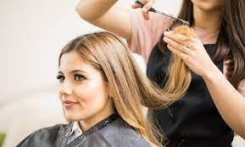
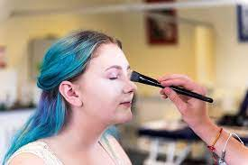
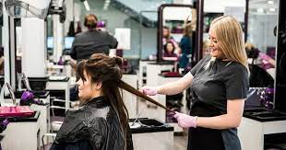
College options
Hair and Beauty at Chippenham College 9.00 - 12.00
Students walk to and from college

Slide 8
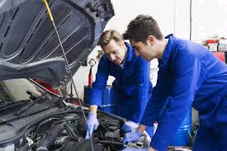
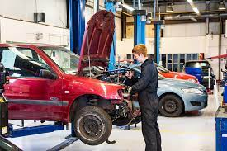
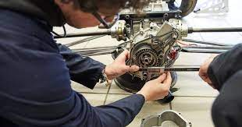
College options
Motor vehicle maintenance at Chippenham College 9.00 - 12.00
Students walk to and from college

Slide 9
Contact us
If you have any queries, please contact Mr M Harrison, mharrison@sheldonschool.co.uk or Mrs S Wilson, swilson@sheldonschool.co.uk

