Slide 1
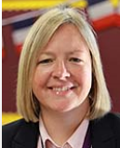
An introduction to GCSE Modern Foreign Languages
What you will learn. Where it could take you. Who should opt.
dmasters@sheldonschool.co.uk

Slide 2
What it gives you
The ability to empathise with others from diverse backgrounds
Proven communication skills

Slide 3
The language choice

Slide 4
What you will learn
My personal world
Media and technology
Lifestyle and wellbeing
Studying and my future
My neighbourhood
Travel and tourism

Slide 5
What you will learn
My personal world
Family, friends and relationships
Equality
My personal world is the theme that will look the most like the one you are used to in KS3. The depth within which we explore this theme and the breadth of grammar we tackle is the difference.

Slide 6
What you will learn
Lifestyle and wellbeing
Physical and mental wellbeing
Food and drink
Sports
Lifestyle and wellbeing is a very important theme and one that often brings lively discussion and debate. Your science knowledge will provide a good background here so for those hoping to pursue a medical career, languages combines well.

Slide 7
What you will learn
My neighbourhood
Places in town and shopping
Transport
The natural world and environmental issues
If you are considering a humanities subject at GCSE, this knowledge will complement that learning. If you plan to travel in the future and broaden your horizons, this knowledge will give you the tools you need to independently make your way through a different country.

Slide 8
What you will learn
Media and technology
Social media and gaming
Music, tv and film
Media and technology gives you the opportunity to discuss how you spend your free time. This could be used in many real-life contexts as you meet new people from different backgrounds and discover shared interests.

Slide 9
What you will learn
Studying and my future
School
Future opportunities
(e.g work and travel)
This theme allows you to think about and discuss your future plans and ambitions. We compare education systems in the different countries and give you opportunities to reflect on your next big steps.

Slide 10
What you will learn
Travel and tourism
Accommodation
Tourist attractions
Linguists who wish to travel in the future will enjoy this theme. The knowledge you learn here will enable you to make your own choices, become more independent and experience new cultures.

Slide 11
How you will be assessed
25%
All assessed in exams at the end of the course

Slide 12
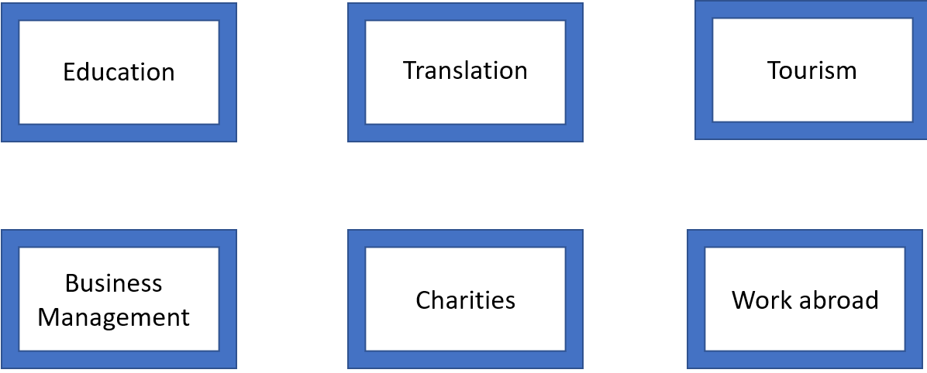
Your future career

Slide 13
Who should opt

Slide 14
Who can help

