Slide 1

Introduction to GCSE Dance
Notes:
Hello and welcome to the introduction to GCSE dance at Sheldon School. I am Miss Merry and Head of Dance at Sheldon.

Slide 2
Core Content
Performance
40 marks; 30%
Choreography
40 marks; 30%
Appreciation
80 marks; 40%
Notes:
At Sheldon School we follow the AQA board which has 3 core components. These are performance, choreography and appreciation. As you can see, the practical element equals to 60% and appreciation, which is the written work, comes to 40%.

Slide 3
Performance
Solo of two of the set phrases;
Breathe, Flux, Scoop, Shift
Duet/trio using material from the other two set phrase that were not used
(3minutes)
- Include a programme note of 120-150words
Notes:
The first component, performance, allows students to show off their technical ability. Students will perform 2 solos which are taught. They will also create a duet or trio integrating movement taught, as well as their own.
These both will be filmed and a programme note will be needed for the duet or trio to assist the examiners understanding of the dance.

Slide 4
Must Understand and Present:
Physical skills
Technical skills
Expressive skills
Mental skills
Safe practice
Notes:
The following skills are fundamental for performance. For example, within physical skills students need to consider posture whereas in expressive skills students need to consider projection.

Slide 5
Choreography
Solo
(2minutes)
OR
Group choreography; 2-5 dancers
(3minutes)
- Include a programme note of 120-150words
Suggested not be in your own choreography
Notes:
The second component, choreography, is an independent study and a performed exam. Student are provided with 5 different stimuli to base their choreography on. They can then choose to create a solo or group performance of 2-5 dancers. Again, this will be filmed and a programme note will be required.

Slide 6
Must Understand and Present:
Action, dynamics, space and relationships (RADS)
Choreographic process
Structuring devices
Choreographic devices
Aural settings
Notes:
The following skills need considering when choreographing. For example, are students highlighting all movement element and taking into consideration the devices to develop their work.

Slide 7
Appreciation
3 Section Paper
Section A:
Knowledge and understanding of choreographic process
Section B:
Critical appreciation of own work
Section C:
Critical appreciation of professional works
Notes:
The third component, appreciation, is a written exam which assesses students on their practical understandings of their own work and six professional dances.

Slide 8
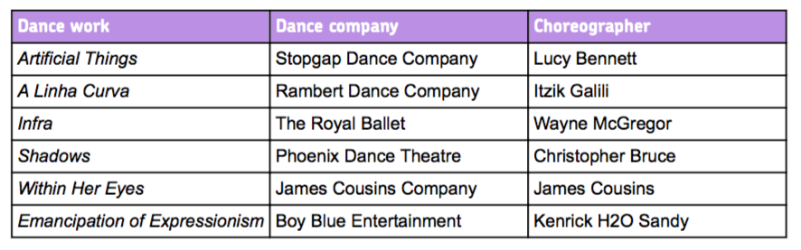
Anthology (Professional Works)
Written exam: 1 hour 30minutes
Notes:
The six professional dances are as follows. All dances have different styles and elements that make them unique. By having such different works, broaden students understanding of what dance is.

Slide 9
Must Understand and Present:
Features of production
Performance environment
Choreographic approaches
Choreographic content
Choreographic intent
Notes:
The following skills are necessary for their understanding of the written paper but will be used practically to ensure complete clarity.

Slide 10
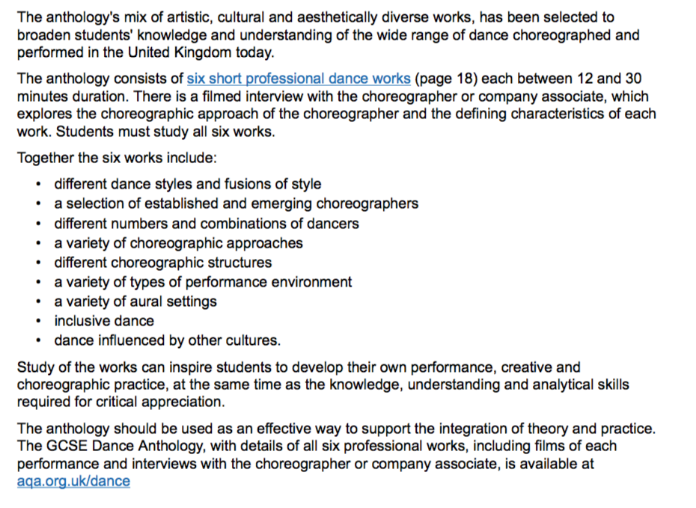

Slide 11
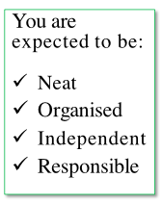
Lessons
You will need to bring each week:
A dance folder
Lined paper
Dance kit
HOMEWORK WILL BE GIVEN EACH WEEK AT LEAST ONCE, IF NOT TWICE
Notes:
The lessons. Students once a week will have a double and a single and will need the following items for each lesson: a dance folder, lined paper and their dance kit.
Each week students will also be given homework. This homework may be on answering questions based on the work completed in class or to choreograph some movement.

Slide 12
Absences
If you are absent you MUST catch up on work. All information given in class is vital and you MUST be responsible for keeping up to date.
You can do this by get notes from friends or contacting me via email
Notes:
Now we are heading into GCSEs, students must catch-up on work missed. All work, specifically the theory, is vital to have notes on. It is student’s responsibility to keep up to date.

Slide 13
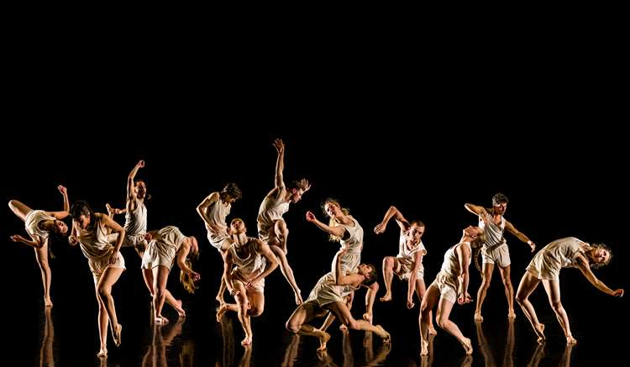
rmerry@sheldonschool.co.uk
Notes:
If you have any questions, please do not hesitate to email me using the below email.

