Slide 1

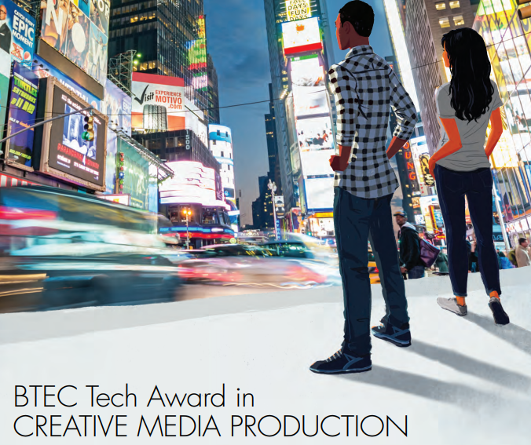



Introduction to Media Studies

Slide 2
What will I get from the course?
Discussion and analysis of: conventions of media products such as films, TV shows, music videos, magazines, posters and video games; the breakdown of target audiences of media products; research into media companies
Development of essay writing skills
You will learn media production skills such as page layout and photography
Highly enthusiastic and motivated specialist teachers

Slide 3


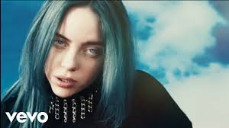
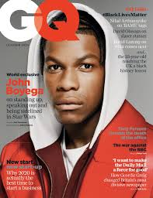



Component 1: Exploring Media Products 30% | Component 2: Developing Media Production Skills 30% | Component 3: Responding to a Brief 40%
This first component covers an introduction to media studies and key concepts such as target audience, genre and structure. We go on to look at 3 sectors in detail: Print and Publishing (Posters, Magazines) Moving Image (Music video, Trailers,TV, Movies) Interactive and Online (Games and Apps) You will produce detailed analysis of the above | This second component focuses on experimenting with a range of production techniques-mainly in the Print sector. We will use a range of web apps for photo editing as well as taking our own photographs. We will go on to use a range of tools in Adobe Photoshop. | Component 3 builds directly on Components 1 and 2, and enables learning to be brought together and related to a real-life situation. The component requires learners to apply their production skills to the creation of a media product in response to a brief. The external assessment takes the form of a set task taken under supervised conditions that is then marked and a grade awarded by the exam board. The final brief could ask students to produce pages from a new magazine; design a brochure to promote a product; to produce a poster campaign.

Slide 4
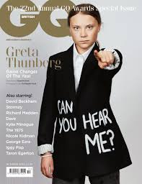
Component 1: Exploring Media Products
This first component covers an introduction to media studies and key concepts such as target audience, genre and structure.
We go on to look at 3 sectors in detail:
Print and Publishing (Posters, Magazines)
Moving Image (Music video, Trailers,TV, Movies)
Interactive and Online (Games and Apps)

Slide 5

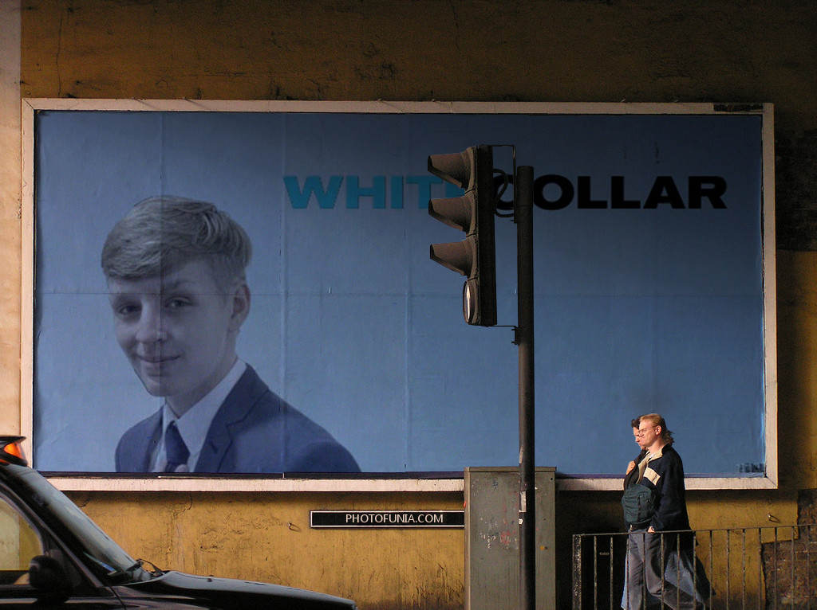

Component 2: Developing Media Production Skills
This second component focuses on experimenting with a range of production techniques-mainly in the Print sector.
We will use a range of web apps for photo editing as well as taking our own photographs. We will go on to use a range of tools in Adobe Photoshop.

Slide 6
Component 3: Responding to a Brief
The third component is an externally assessed controlled assessment.
The exam board, Pearson, set a brief which you need to plan for and then execute in a limited amount of time in controlled assessment conditions at school.
This final piece will be challenging but builds on all of the things you have learnt from the course. You will be assessed on both your planning work as well as the final piece.
The brief could be to create some pages for a new magazine, a brochure or a poster campaign.
Previous briefs have included creating print products to promote: diversity, physical health, volunteering, community
.

Slide 7
Skills and possible pathways
Skills
Textual analysis of media language across a range of media texts
Industry insight into a variety of media products
Media production using image/video editing tools as well as use of media hardware such as cameras, lights and backdrops.
Possible Pathways
Level 3 courses here at Sheldon or elsewhere- such as A-levels or Level 3 BTECS.
There are a wide range of Media degrees at unis across the country
Careers: advertising and marketing, writing and journalism, business, teaching, performing arts, academia; creative media production in areas such as radio, graphic design, film, television and digital moving image.

