Slide 1




GCSE Business
Mr Rand and Miss Tuttiett

Slide 2
The content of GCSE Business Studies
Year 10: Theme One
Studying how a small business operates
Investigates local businesses
Topics include: Ownership Finance External influences
In Year 10, you can expect to learn:
Why people decide to set up a business.
What types of business there are in the UK.
How to work out if a business is making a profit or loss.
What could help or stop the business from being successful.

Slide 3
The content of GCSE Business Studies
Year 11: Theme Two
Studying of how a business could grow
Investigate national and global businesses
Topics include: Marketing Operations Human Resource Management
In Year 11, you can expect to learn:
How a business grows from a small organisation to a large multi-national company.
How to make and market a successful product
How to manage staff and be a leader

Slide 4
The exam structure for GCSE Business Studies
Theme 1 | Theme 2
Paper 1 | Paper 2
1 Hour 45 Mins | 1 Hour 45 Mins
Multiple choice questions Calculation questions Short and extended questions Case studies and theoretical questions
100% exams
Allow use of business knowledge to support understanding of key concepts

Slide 5


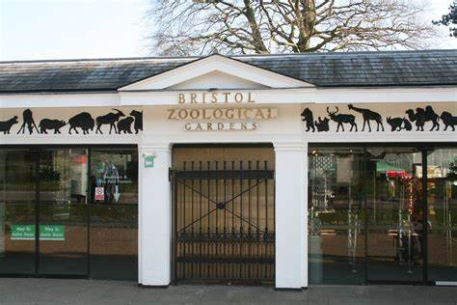
Understanding the business world
Students will benefit from experiencing the running of local and national businesses.
Students will be given the opportunity to understand how businesses work on a day to day and strategic level.

Slide 6



Understanding the business world
Every business will expect their staff to have good personal skills:
Communication skills
Analytical skills
Evaluative skills
Organisational skills
Initiative
Research skills
Teamwork

Slide 7




How does GCSE Business help after Year 11
A Level Business
Apprenticeships e.g. business administration
Provides foundation for a variety of careers

