Slide 1
VOCATIONAL AND ASDAN PSE (Personal and Social Effectiveness – formerly ASDAN CoPE)
Vocational Qualification

Slide 2
Vocational Learners
Students who follow this course:
Prefer practical tasks
Are good at making things with their hands
Struggle to complete lots of homework on time
Already have an idea of what you want be when you leave Sheldon
Like to work as a team

Slide 3
ASDAN PSE
All Portfolio Based – No exams and no regular homework set. Giving students more time to focus on their other subjects.
Covers key skills
The Challenges cover areas such as:
Developing myself and my performance
Working with others
Problem solving
Delivering a project – Year 11

Slide 4
ASDAN PSE Modules
Developing myself and my performance - DM
Health and wellbeing
International links
Digital communications
Beliefs and values
Working with others - WW
Citizenship and community
The environment
Enterprise
Sport and leisure
Beliefs and values
Problem solving - PS
Science and technology
Expressive arts
Independent living
Vocational preparation
Delivering a project – DP (Year 11)

Slide 5
Qualifications
Units DM, WW, PS and DP are required for the Certificate in Personal and Social Effectiveness (Levels 1 and 2)
Level 1 Certificate = (Level 3 GCSE equivalent)
Level 2 certificate = (Level 5 GCSE equivalent)
All Portfolio no Exam!!!
No frequent homework's set allowing students more time to focus on
Separate Level 1 qualification awarded by Wiltshire College for the retrospective course followed.

Slide 6
College options for the Vocational part of the course
Students spend one morning a week at Wiltshire College and University Centre where they study one of the following courses:
Hair and beauty*
Motor vehicle maintenance*
Animal care*
* NB subject to availability
Year 10s Attend Wiltshire College on Thursday mornings 9-12
Year 11s Attend Wiltshire College on Monday mornings 9-12

Slide 7
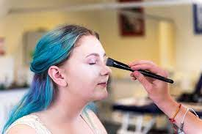
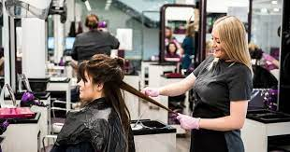
College options
Hair and Beauty at Chippenham College 9.00 - 12.00
Students walk to and from college

Slide 8
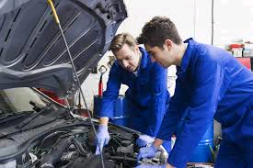
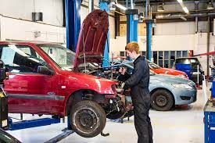
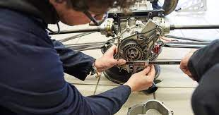
College options
Motor vehicle maintenance at Chippenham College 9.00 - 12.00
Students walk to and from college

Slide 9
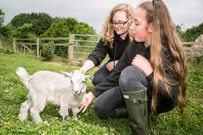
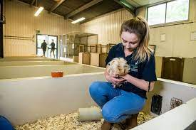
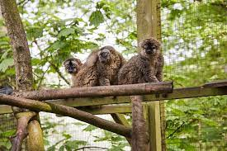
College options
Animal care at Lackham College 9.00 - 12.00
Students use the School minibus to and from Sheldon to Lackham college

Slide 10
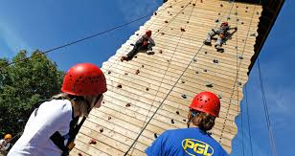
Residential trip
In the summer term of year 10 we endeavour to hold a residential trip to South Wales for 3 days.
N.B. Dependant on Covid restrictions.
Activities include;
Gorge jumping
Rock climbing wall, high ropes, zip line.
Team building
Students do all the cooking for the trip, including buying all the food for the trip and managing the budget.
Build confidence and learn how to work as a team.
If you have any queries, please contact Mr M Harrison, mharrison@sheldonschool.co.uk or Mrs S Wilson, swilson@sheldonschool.co.uk

