Slide 1


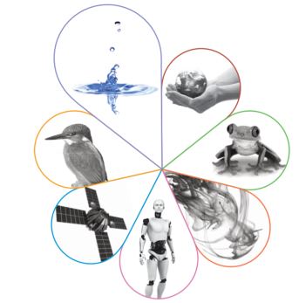



GCSE Science - overview
GCSE science is a compulsory subject and all students will be taught aspects of biology, chemistry and physics.
There are two possible routes, both, allow students to access all of the science A levels courses.
The majority of our students will follow the trilogy award. This will give them a double GCSE grade such as 99, 88,77 etc.
A number of students will be invited to follow the separate science award. This will give them three GCSE grades, in biology, chemistry and physics.

Slide 2
GCSE Combined Science:Trilogy
The Trilogy Science GCSE qualification encourages students to be inspired, motivated and challenged by following a broad curriculum that focuses on working scientifically. It provides an insight into and experiences of how science works, stimulating students’ curiosity and encouraging them to engage with Science in their everyday lives.
Students will gain the equivalent of two GCSEs.
They will cover aspects of Biology, Chemistry and Physics as well as investigative skills. This course provides a solid foundation for studying all A Level science courses.
Examination – six papers, 2 from each discipline and each paper is 1 hour 15 minutes.
Exam Board - AQA

Slide 3

GCSE Separate Sciences
The Separate Science GCSE qualification encourages students to be inspired, motivated and challenged by following a broad curriculum that focuses on working scientifically. It provides an insight into and experiences of how science works, stimulating students’ curiosity and encouraging them to engage with Science in their everyday lives.
Students will gain three GCSE qualifications, one for each discipline.
They will cover a wide range of Biology, Chemistry and Physics topics as well as investigative skills. This course provides a solid foundation for studying all A Level science courses.
Examination – six papers, 2 from each discipline and each paper is 1hr 45 minutes
Exam Board - AQA

