Slide 1





An introduction to GCSE Modern Foreign Languages
What you will learn. Where it could take you. Who should opt.
dmasters@sheldonschool.co.uk

Slide 2

What it gives you
The ability to empathise with others from diverse backgrounds
Proven communication skills

Slide 3

The language choice

Slide 4

What you will learn
Identity and culture
Local, national, international and global areas of interest
Current and future study and employment

Slide 5
What you will learn
Identity and culture
Me, my family and friends
Technology in everyday life
Free time activities

Slide 6
What you will learn
Local, national, international and global areas of interest
Home, town, neighbourhood and region
Social issues
Global issues
Travel and tourism

Slide 7
What you will learn
Current and future study and employment
My studies
Life at school and college
Education post-16
Jobs, career choices and ambitions

Slide 8

How you will be assessed
25%
All assessed in exams at the end of the course

Slide 9
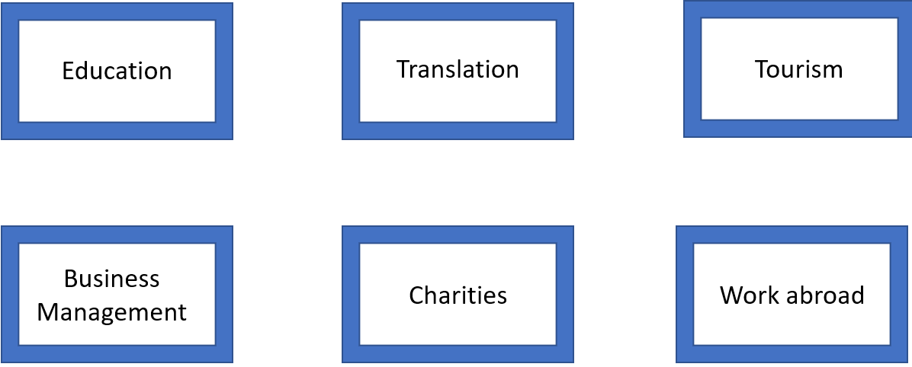
Your future career

Slide 10

Who should opt

Slide 11

Who can help

