Slide 1
PEA FACULTY
Edexcel GCSE DRAMA
SHELDON SCHOOL DRAMA
SHELOSHEN SCHOOL DRAMA
SHELDON SCHOOL DRAMA

Slide 2
Edexcel GCSE DRAMA
SHELDON SCHOOL DRAMA

Slide 3
Edexcel GCSE DRAMA
I think there is no world without theatre
E. Bond

Slide 5
Key Skills In GCSE Drama
Oral Communication Skills
Respect for Deadlines
Creative Problem Solving
Adaptability and Flexibility
Team Work
Working Under Pressure
Self Discipline
Confidence
Leadership Skills
Respect for Colleagues
Notes:
Images taken from www.pixabay.com and are all royalty free.

Slide 6
Edexcel GCSE DRAMA
Building skills for life

Slide 7
WHAT’S IT MADE UP OF?
Edexcel GCSE Drama is made up from three componentsWHAT

Slide 8
Edexcel GCSE Drama is made up from three components
Component 1:
Devising
Component 2:
Performance From Text
Component 3:
Theatre Makers in Practice

Slide 9
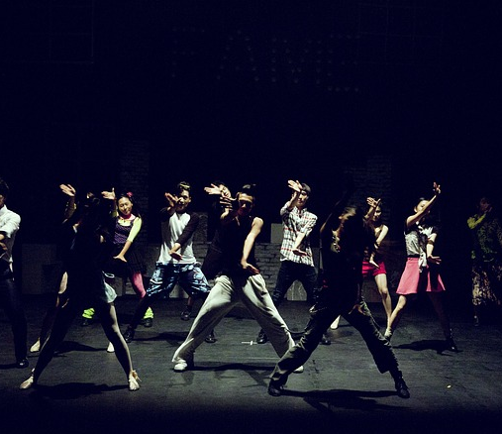
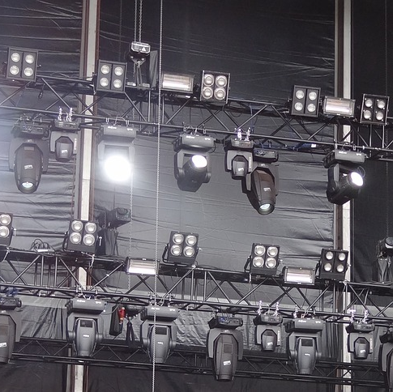
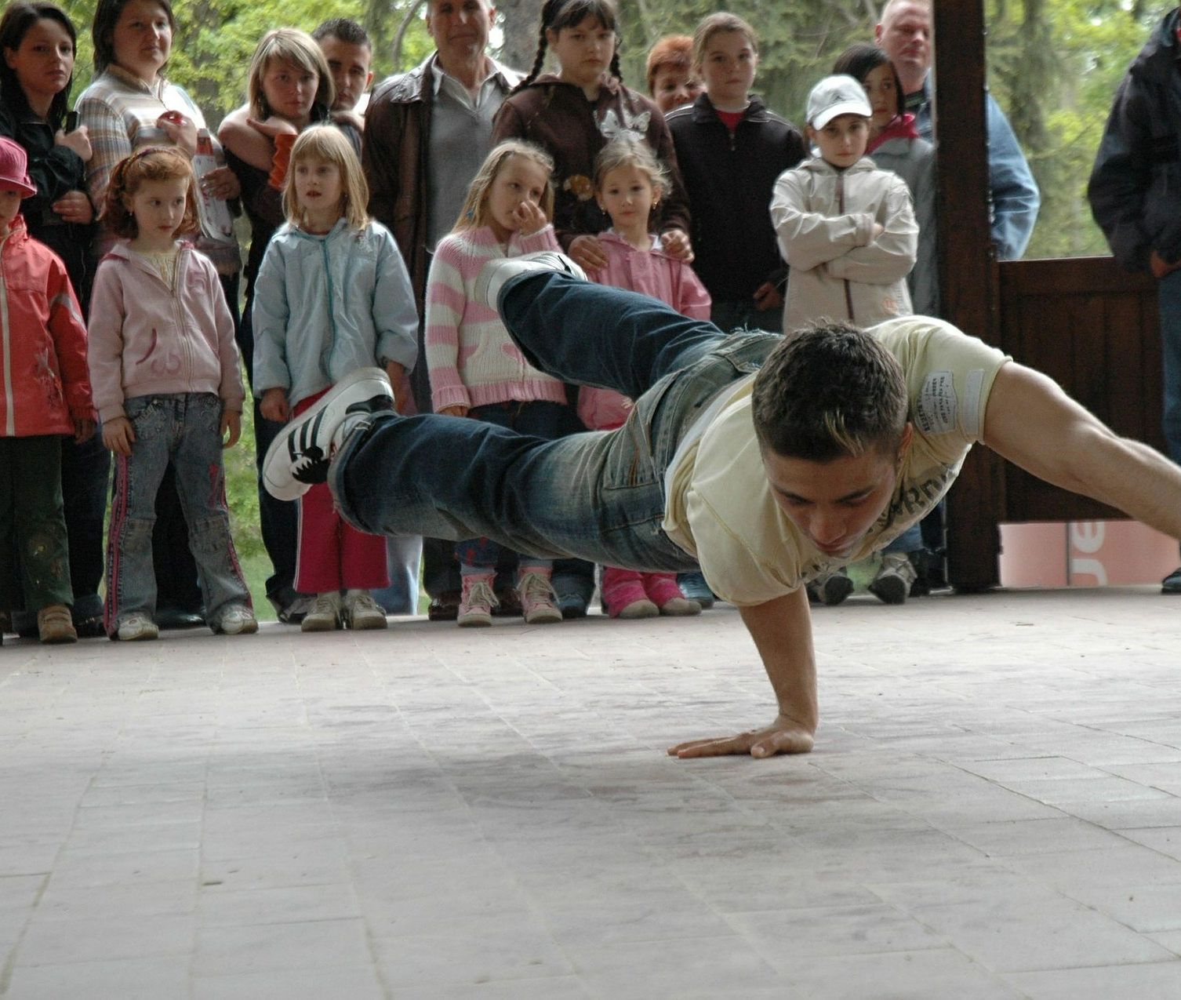
Component 1: Devising
Create and develop a devised piece from a stimulus (free choice for centre).
Performance of this devised piece or design realisation for this performance.
Analyse and evaluate the devising process and performance.
Performer or designer routes available.
Assessed in a Written Devising Log worth 45 marks and a Devised Performance worth 15 marks.
Notes:
Images taken from www.pixabay.com and are all royalty free.

Slide 10
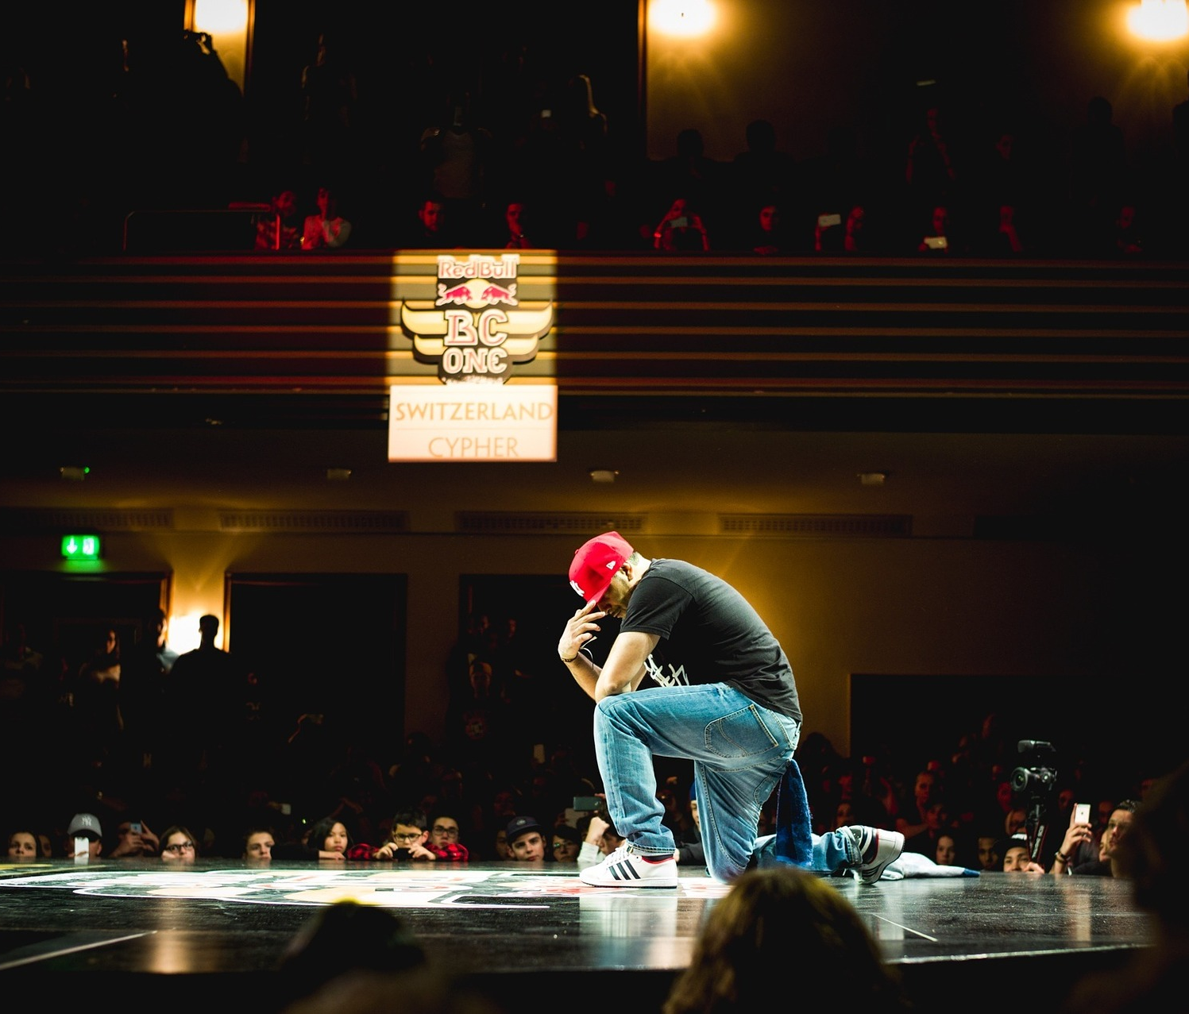
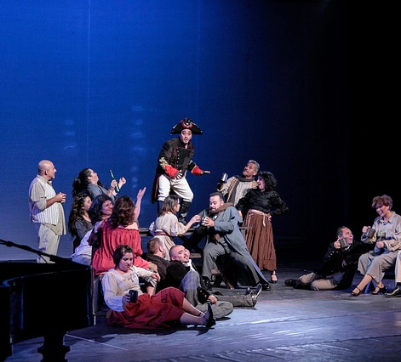
Component 2: Performance From Text
Performance of two extracts from one play (students may contribute as performer or designer)
Assessment in Performance
Notes:
Images taken from www.pixabay.com and are all royalty free.

Slide 11
Component 3: Theatre Makers in Practice
Knowledge and understanding of drama and theatre
Study of one set play from a choice of six
Analysis and evaluation of the work of live theatre makers
Assessed in a Written Exam lasting 1 hour and 45 minutes
Notes:
Twelfth Night Image taken from: https://www.nottinghamplayhouse.co.uk/whats-on/drama/twelfth-night/
Blue Stockings Image taken from: http://www.111theatre.co.uk/new/bluestockings.php
DNA Image taken from: http://capitalt.org/wp/past-production/dna-by-dennis-kelly/5487

Slide 12
Edexcel GCSE Drama is made up from three components
Component 1: Devising
Creating, performing and writing about a performance you have made yourself.
Component 2: Performance From Text
Performing extracts from a script to an examiner.
Component 3: Theatre Makers in Practice
Written Exam on a practical study of a play.

Slide 14
Where will GCSE Drama take you?
LAW
TEACHING
MEDICINE
ACTING
BUSINESS
BANKING
JOURNALISM
Notes:
Images taken from www.pixabay.com and are all royalty free.

Slide 15
Where will GCSE Drama take you?
Anywhere!
All employers and university tutors are seeking to recruit individuals who can demonstrate key skills such as confidence, communication skills and leadership.
Notes:
Images taken from www.pixabay.com and are all royalty free.

Slide 16
Employment Skills

Slide 17
Employment Skills
Oral Communication Skills
Respect for Deadlines
Creative Problem Solving
Adaptability and Flexibility
Team Work
Working Under Pressure
Self Discipline
Confidence
Leadership Skills
Respect for Colleagues
Notes:
Images taken from www.pixabay.com and are all royalty free.

Slide 18
Edexcel GCSE DRAMA
What is drama but life with the dull bits cut out
A. Hitchcock

Slide 19
Edexcel GCSE DRAMA
SHELDON SCHOOL DRAMA
Building skills for life

Slide 20
PEA FACULTY
Edexcel GCSE DRAMA
Swhite@sheldonschool.co.uk
SHELDON SCHOOL DRAMA
S

