Slide 1
GCSE Computer Science
Mr Shaw

Slide 2
Computer Science GCSE– overview
5 lessons a fortnight (usually 2 x double, 1 single)
2 exams – Edexcel exam board. 1 programming exam (taken on a computer), 1 theory exam (paper based)
All software provided
Python programming language extensively used
HTML, Assembly, Javascript, SQL and many others used as well.

Slide 3
Computer Science – Skills and Careers

Slide 4
Why choose Computer Science?
Computers are changing every part of our lives at an ever-increasing rate – why not drive the future?
In this GCSE:
Experience programming and making new software
Find out how hackers attack computers, and other cybersecurity topics
Discover how computers work
Solve logical problems
Our GCSE (9–1) Computer Science 2020 qualification offers an exciting, practical focus on real-life programming, developing skills relevant to the future.
Our qualification provides a practical approach to developing computational skills. This includes innovative, practical onscreen assessment to ensure all students develop the computational skills they need for an exciting digital future beyond the classroom.

Slide 5
What will I learn?
This GCSE will equip you with a range of transferable practical and theoretical skills.
Paper 1: Principles of Computer Science
Computational Thinking
Data
Computing Hardware
Networks
Issues and impacts

Slide 6
What will I learn?
This GCSE will equip you with a range of transferable practical and theoretical skills.
Paper 2: Application of Computational Thinking (programming exam)
Problem solving with programming
Algorithms - reading, writing and assessing
Decomposing and analysing problems
Ability to read, write, refine and evaluate programs.

Slide 7
What will a computer science lesson look like?
The theoretical aspects of the course and the practical programming elements work hand in hand across all lessons.
This means that wherever possible, the theory we cover is backed up with practical activities, and vice-versa!
We use blended approaches frequently – homework tasks are often based around note taking, with the following lessons building on the notes.
Practical programming is absolutely central to the course – from day one you will be programming (usually Python). You will gain a lot of practical experience across the course, making many many small programs and some larger ones.

Slide 8
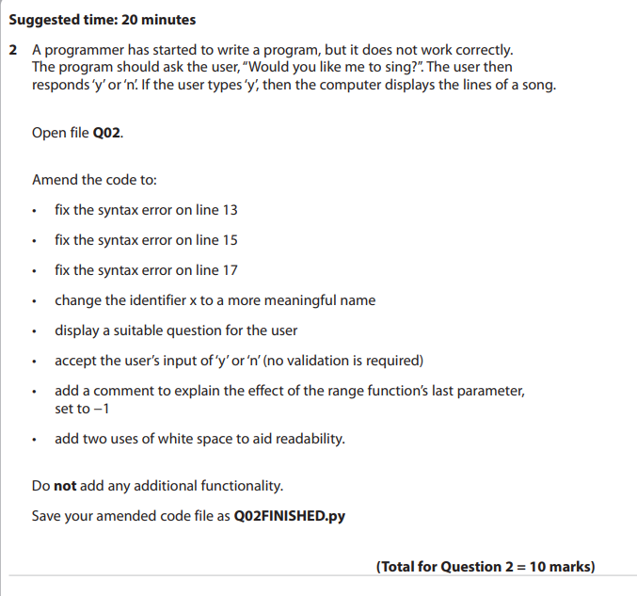
What will the exams look like?
A typical paper 1 question – testing theoretical knowledge of a standard search algorithm
This question is from a programming exam…you will get some code files for use during the exam. Here you can see the question asks you to fix errors, and explain the functionality of the code.

Slide 9
contact
tshaw@sheldonschool.co.uk
Mr Shaw, C4 or BEC office

