Slide 1
GCSE Business

Slide 2
Why Choose GCSE Business?
You will gain a great understanding of how organisations operate. This will be useful for any company you join or interact with and your knowledge of the ins and outs of the running of a business will make you a useful, adaptable and confident employee

Slide 3
Why Choose GCSE Business?
Good decision-making is an invaluable quality. Business Studies will allow you to develop the ability to quickly and efficiently make sensible, logical and informed decisions. This will save you time and hassle in both your personal and professional life and will hopefully stay with you throughout your entire life.

Slide 4
Why Choose GCSE Business?
Studying how organisations adjust to a changing market will teach you how to be an adaptable, flexible person. This is an extremely useful and desirable quality that will make you more than capable of taking on multiple roles within your career. Also you’ll be more than happy to accept that amazing promotion, knowing that you can step up and adapt to the workload.

Slide 5
Why Choose GCSE Business?
Business Studies also forces you to be organised and to plan ahead. Learning how to generate marketable ideas, access resources and develop business plans all require a great deal of organisation. This, of course, is a crucial skill that will definitely serve you well no matter what career you decide to pursue

Slide 6
Why Choose GCSE Business?
Problem solving is a significant part of Business Studies. Aspects of the course such as coming up with a business plan that works, adapting to changes in the market and deciding whether or not it would benefit a company to employ people all require problem solving. You will become very good at coming up with elegant and logical solutions to problems which employers, of course, love.

Slide 7
Why Choose GCSE Business?
Presentation skills are really important so a subject that allows you to develop them is a definite advantage. Practising presenting improves your oral communication, diction and confidence, which are all valuable life skills

Slide 8
Why Choose GCSE Business?
Theme 1 – studying how a small business operates – Paper 1
Theme 2 – more detailed study of a how a business could grow – Paper 2

Slide 9
What will I study?

Slide 10
What de the exams look like? Some short questions

Slide 11
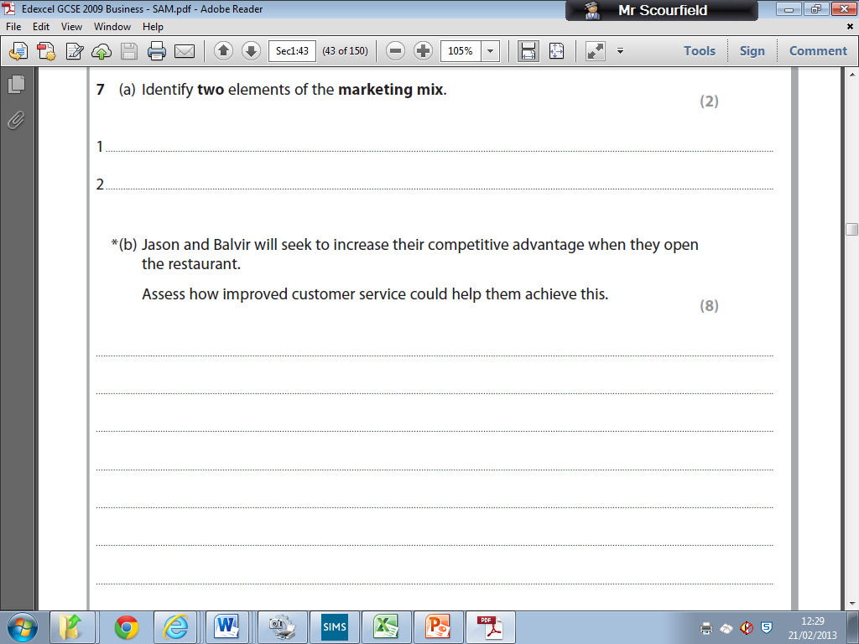
And longer questions

Slide 12
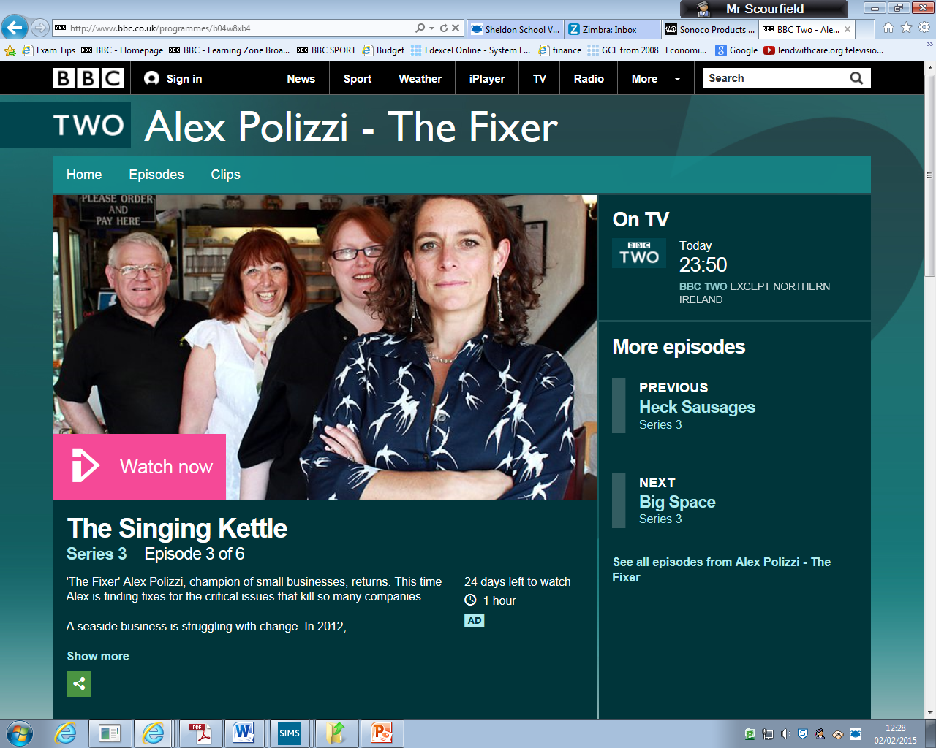
One of the major topics is Marketing, this involves meeting the needs of your customers.
A little bit like this The Fixer

Slide 13
How will I achieve my grade ?
100% of your grade is examined, there is no coursework.
This is similar to most of the 9-1 new GCSE’s
There are 2 exams at the end of the course

Slide 14
Questions?
Please speak to Mr Scourfield, Mrs Kemp Dao, or Mr Screen

Slide 15
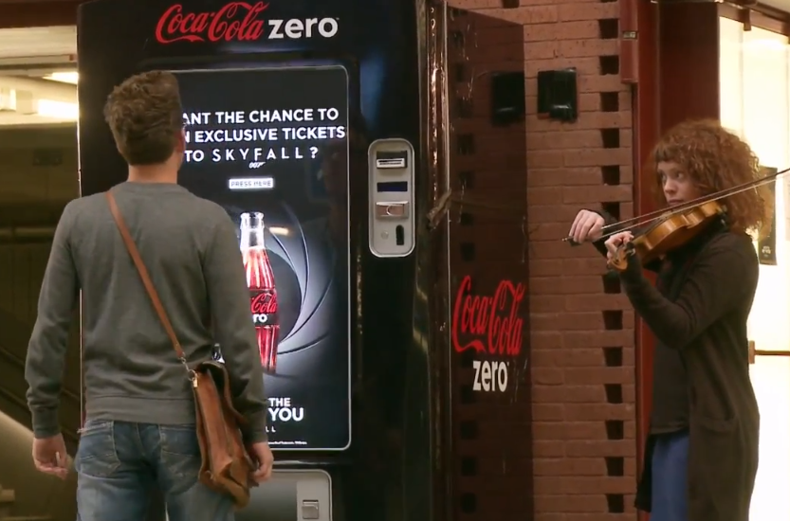
See an example of viral marketing

